Slide 1
Welcome
Notes:
SAY – Welcome to all RGM’s and ASLs to the Own The Zone workshop.
DO – Thank all participants for taking out time from their store responsibilities to attend the session
DO – Invite market manager to address the team and explain why he/she believes ‘Own The Zone’ is important

Slide 2

India’s most loved & trusted food service brand
Our Vision
Notes:
ASK –
Why is having a vision important?
How does our vision impact us and the customer?
What are visions of other brands?
Nike – To bring inspiration and innovation to every athlete. If you have a body, your are an athlete.
DISCUSS –
The significance of ‘Love’ and ‘Trust’
Why food delivery and not pizza delivery.

Slide 3

Current Reality
Store Counts - 603
ADS – 65k
TXN- 260
Store Counts – (PHD-118, RBD – 88)
Total Delivery points- 276
ADS – 43k
TXN - 130
Powerful adversary
Notes:
SAY – “While our adversary is bigger and more powerful we have certain advantages over them. What are these advantages?”
Get Responses –
Small means quicker
Smaller results in quicker decision making and execution
DO – Instill pride in the team.
DISCUSS –
Smaller and lesser know brands have won. Apple vs. IBM, Honda vs. GM
RGMs who have taken the battle to our competitor within our trade zone and seen victory
SAY – It is important to also know that we need to increase our transaction and sales to be able to become the number 1 brand in the country. Our business model requires us to increase sales to 60K ADS and 172 transactions per day.

Slide 4
We WANT this to change…SOON
Notes:
SAY – This battle is far from over. Our competitors are strong and are fighting to regain lost ground. This is a street fight within every trade zone which we will win thanks to the commitment of our RGM’s and our store teams”
DO – Build the analogy of our teams being troops fighting this battle for our trade zones. Our RGM’s are the captains who are leading this battle at the frontline.
ASK –
How many of us here have spent more than a year with Pizza hut?
How was our sales performance from Jan 2013 to June 2013?
Are you glad and delighted that we have fixed the value proposition and see sales improve since the launch of magic pan?
Allow time for the team to savor this recent victory

Slide 5





Our Battle Plan To WIN
Notes:
ASK-
What is HOP to Win?
How is it going to help us?
GET RESPONSES-
It is our unique Pizza Hut delivery culture –
Hustle is all about speed . We need to ensure we serve customers on time without
compromising on safety.
Own the Zone – Every household is a potential customer. Customer will order with us if we
provide them with our contact details and our menu. When they order, we need to ensure
that they are completely satisfied and return to us.
Passion for Product – Every product made in our kitchen is of the finest quality
We need to ensure that everyone on our team is completely aware of these 3 unique
mindsets and constantly display HOP behavior

Slide 6
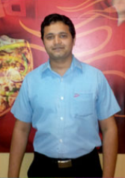


Our Captains In This Battle
YOU!...
Notes:
Recognize RGMs who have led their troupes to victory.
Recognition Criteria –
Highest sales growth
Highest net new customers
Best celebration week execution
DO – Ask the team to recognize RGM’s who have made significant improvement in the store sales . Instill pride in the team

Slide 7


Do’s & Don'ts
The most important rule
Participate & have fun !
Notes:
SAY- This is a workshop. Your experience and knowledge is very important. Share experiences as we discuss how to win in our own trade zones.
Switch off your phone or forward calls to the manager on duty so that you are not disturbed.
It is important that you are completely focused. Ask question and participate in discussions.
I will be asking questions and the right answers will be rewarded with…….
This workshop includes many activities. These activities are to be solved in teams.
DO-
Form teams of 4-6 on each table. Make groups where there is a mix of RGMs from various patches and ASL’s.
Appoint a timekeeper for the session.

Slide 8
Own The Zone
Trade zone Supremacy
Notes:
ASK – Before we begin the workshop, please let us know what you expect to gain by the end of this workshop.
DO- List down all expectations on a flip chart. Revert to the expectations at the end of day 2 to check if all expectations are met.

Slide 9
Course Objective
Equip YOU, our captains on the frontline, with the weapons and strategy to win the Battle for ‘OUR TRADE ZONES’
Notes:
DO –
Once the expectations are listed, make a note of any expectation which may not be met during the course of the session. Ensure that those expectations are addressed in a timely manner. Ensure all concerns are noted and addressed with the operations leader.

Slide 10

You Will Learn
5.
Measuring
Results
4.
Local Store
Marketing
1.
Understanding
Sales
3.
Maximize sales outside the store
2.
Maximize sales inside the store
Notes:
DO –
Mention the sequence of the sections and how the modules are inter-related and linked.

Slide 11

Table Of Contents
1
Understanding Sales
2
Maximizing Sales Inside the Store
3
Maximizing Sales Outside the Store
4
Local Store Marketing
5
Measuring Results

Slide 12
Day1
1
Understanding Sales
What is sales
Understand your delivery sales potential
Indentify sales opportunities
2
Maximizing Sales Inside the store
Carryout customer
How do we maximize sales in carryout
Friend on the inside
Notes:
DO –
Outline the agenda for the workshop so that participants are aware of how time will be managed through the course of the workshop. Mention break and meal timings.

Slide 13
Day 2
3
Maximizing Sales Outside the Store
trade zone
Leafleting
Measuring results
4
Local Store Marketing
Analyze opportunity
Choose the right tool
Execute plan
Notes:
SAY- On day 2 we will explore how to maximize sales in our trade zones, drive LSM based on our sales opportunities and measure results.

Slide 14
Day 2
5
Measuring Results
New Customer
Lapsed Customer
Re-activated Customer
Net New Customer
Notes:
SAY- The final section is on measuring results of all the Own the Zone activities we conduct.
Take questions before proceeding

Slide 15
Understanding Sales
5.
Measuring
Results
4.
Local Store
Marketing
1.
Understanding
Sales
3.
Maximize sales outside the store
2.
Maximize sales inside the store
Notes:
SAY – Before we begin building sales, it is important to understand what are the various facets of sales. This is the first module on Own The Zone.

Slide 16
What is Sales?
Notes:
ASK -
What is sales.?
How do we define sales in a Pizza Hut?
Why is sales important ?
GET RESPONSES-
Sales is the revenue earned for all service and product delivered to customers.
Sales has 2 factors – transactions and APC
Sales indicates how many customers love and trust our brand and how much they are willing
to spend to have a meal at pizza hut. If sales are high, it indicates that we are growing and
have growth potential

Slide 17
Sales
Transaction
APC
Sales
X
=
Sales increases if any of the two components increases
Notes:
ASK –
Are there any other ways of increasing sales?
For long term growth, should we focus on transactions or sales
GET RESPONSES-
While APC is important, APC cannot be increased beyond a certain level. Every transaction
gives us additional sales . True growth takes place when more customers order with us.

Slide 18
When does Txn rise?
Transaction
Add new customer
2. Increase frequency
What can you do to increase transactions?
Notes:
ASK - What can you do to increase new customers?
DISCUSS

Slide 19
Transaction= Customers
1
New Customers
2
Active Customers
3
Lapsed Customers
Notes:
ASK
What is new customer?
What is active customer?
Lapsed Customer?
Where do we get this data?
ALLOW TIME FOR DISCUSSION BEFORE PROCEEDING

Slide 20
What do we need to do?
1
New Customers
Acquire New Customers
2
Active Customers
Increase Frequency
3
Lapsed customers
Prevent Lapsers
Re-activate Lapsers
Lapsed Customers
Notes:
ASK – How do we use this information to increase sales?
ALLOW DISCUSSION BEFORE PROCEEDING

Slide 21
Increase New Customer
New Customer
How?
1. Penetrate existing pods
2. Activate new trade zones
What can you do to increase new customer acquisition?
Notes:
ASK-
1. What is penetration?
2. What is activity?
GET RESPONSE
1. Total database / Total HH in trade zone
2. Data base of customers who have ordered in last 90 days/ total database

Slide 22
Increase Frequency
Frequency
How?
Great service & product
2. Bounce back
3. Offer value
What can you do to increase Frequency?
Notes:
ASK- How can we increase frequency?
GET RESPONSE
Recognizing customer names and food preferences.
Rembering their prev order
Occasions – birthdays, anniversary etc
Frequency – how many times the customer has ordered with pizza hut.

Slide 23
Prevent Lapsed Customer
Lapsed Customer
How?
On time service
2. Great product quality
3. Great leafleting
4. Complaint handling
What can you do to prevent lapsers?
Notes:
ASK
1.Why do customers lapse?
2. How can we prevent lapsation?
GET RESPONSE
Why customers lapse
Poor service – delayed order (Especially O40’s)
Unresolved complaints
Poor Product
Preventing lapsation
On time and great service
Great product quality
Effective leafleting

Slide 24
Reactivate Lapsed Customers
Lapsed Customer
How?
1. Give attractive offers
2. Call backs
What can you do to re-activate lapsed customers?
Notes:
ASK -
Why is it important to win back lapsed customers?
Cost of a single customer to the brand –
Customer frequency = Once in 45 days = 8 times a year
APC = Rs 400.
Cost per customer per year = 400 x 12 = 3200
Loyal customer come to the same brand for approximately 20 years.
Cost of a loyal customer = Rs 64000/-
Happy customers recommend the brand to 4 persons
Total value of a loyal customer = 64000 X 5 = Rs 320000/-
Unhappy customers share their experience with 9 other.
Cost of unhappy customer = 64000 X 10 = Rs 6,40,000/-
SAY – Heavy discounting is a tried and tested method to win back lapsed customers. Our endeavor should be to prevent a customer from lapsing.

Slide 25
When Does APC Rise?
APC
More items per person
2. Larger group size
3. Premium products
What can you do to increase APC?
Notes:
ASK-
1. How do we sell more items per person?
Ans : Suggestive selling and adding sides
2. How do we increase group size?
Ans: Birthday parties, Corporate meals, etc.
3. What are other activities to increase APC?
DISCUSS AND SHARE BEST PRACTISES

Slide 26
How Do We Generate Sales?
Putting it all together
Sale
Day part
Day part
Transaction
Average Check
Channel
Channel
New
Customers
Visit
Frequency
Premium
Products
Items per
Person
Group Size
Notes:
DO- a recap of what is sales. Ask the participants to summarize.
SAY – This one flow chart is extremely important to understand sales. All sales activities stem from one or more of these aspects of sales

Slide 27
You Should Know Your Sales Potential
Notes:
ASK - How do we know the sales potential of any trade zone?
SAY - This activity will help us ascertain what is the true potential of our trade zone”
DO – Split the participants into teams. These teams will ideally include an area coach and his team of RGM’s.
Inform teams to take out their calculators to do this exercise.

Slide 28


Calculate Delivery Sales Potential
You Need To Know
1
2
trade zone
Household count
Demographics
Potential Pizza Hut users
Ordering Pattern
Order frequency
Ticket average
Formula to calculate delivery sales potential
Sales Potential:
(# potential users x order frequency x ticket average) /30 days
Notes:
SAY – Let us do a sales potential calculation based on the data provided. This will be an illustrative activity.
You need data from the trade area (Household count), APC and frequency.
Frequency is measured by calculating how many orders are placed per month

Slide 29


Exercise
1
2
trade zone
Household count: 14,500
Demographics: SEC- A,B
Potential PH users: 6150
Ordering Pattern
Order frequency: Every 30 days
Delivery tickets: Rs 300
Answer
Sales per day = (6150 x 1 x 300) / 30 days =Rs 61,500
Notes:
ASK – Calculate the sales potential for this trade zone.
DO – Click to open boxes 1 and 2. Wait for the team to calculate using the formula given on the previous slide before confirming the answer which is in the final box .
Reward teams that have got the right answers

Slide 30

Activity
Activi
vity
1
trade zone
Household count: 17,400
Demographics: SEC- A,B
Potential PH users: 100%
Ordering Pattern
Order frequency: Every 60 days
Delivery sales : 670,000
Delivery tickets: 2500
2
Calculate the daily sales potential
Notes:
ASK – What do you think is the potential households in our trade areas considering that we now have a fantastic value proposition in magic pan.
GET RESPONSE – 100%
SAY – Please calculate the sales potential from this trade zone. Teams need to hustle, but more importantly their answers need to be accurate. Teams to share the results once they have completed the exercise
DO – Build the competitive spirit of the teams.

Slide 31
Understand Sales Potential
Activity
% Potential PH Users
Households in trade zone
Potential PH users: 100% of 17, 400 = 17,400
Order frequency: One order every alternate month
Monthly Sales
Monthly tickets
APC
Ticket average: 670,000 / 2500 = Rs.268
Potential users
frequency
APC
Monthly Sales potential
Sales potential: 17400 x 0.5 x 268 = Rs. 23,31,600
Monthly Sales potential
Days
Daily Sales potential
Daily sales potential: 23,31,600 / 30 = Rs.77,720/-
Notes:
DO – Explain the calculation so that it is clear to everyone.
DO – All RGMs to calculate the sales potential for their respective trade areas using this logic.
Ask each table to present one stores calculation using the flip charts
SAY – If we were able to achieve in 10% more of our potential than we currently do, will we be able to meet our sales targets. In the next modules we will discuss more about how we can achieve our sales potential
ALLOW TIME TO DISCUSS

Slide 32
Analyze Sales Opportunity – Case Study
Notes:
SAY – We have just completed assessing sales potential in our trade zone. As a business leader, it is also important to be able to indentify sales opportunities in our current business. Lets us find out how these opportunities can be identified.”
DO – Inform teams to take out their calculators to do this exercise.

Slide 33
Case Study 1
Activi
vity
Store Facts
Store Name | ‘Halla Bol’
Opened | 20th Nov, 2010
DEL : T/A | 66% : 34%
trade zone | Corporate & Residential
Bikes | 20 bikes
Competition | Dominos - ADS 80K MacDonald's- ADS 120K
You are a special task force commando
Your mission is to identify the problem
You only have the data on the following slide
Notes:
SAY – This is a simulation inside a live store. Each group needs to use the data on the slide to complete the mission of identifying the sales opportunities. Teams get rewarded for speed and accuracy.

Slide 34
Case Study 1
Study the data for PHD ‘Halla Bol’
 | Jan | Feb | Mar | Apr | May | Jun
ADS | 80,000 | 75,000 | 78,000 | 72,000 | 68,000 | 65,000
Transactions | 260 | 260 | 250 | 240 | 220 | 220
Ticket Average | 308 | 288 | 312 | 300 | 309 | 295
Identify the area of opportunity to improve sales
Notes:
ASK – Are you able to spot the sales opportunity from the data provided?
DO – Show the ADS, transactions and ticket average.
DO– Show the right answer.

Slide 35
What Other Data Do You Require ?
Notes:
ASK - Is there any other data required to be able to understand the exact nature of the sales opportunity?
GET RESPONSE
Channel-wise sales
Day part

Slide 36
Case Study 1 contd..
Transactions | Jan | Feb | Mar | Apr | May | Jun
Delivery | 172 | 160 | 150 | 140 | 120 | 115
Take Away | 88 | 100 | 100 | 101 | 104 | 107
Delivery Transactions | Jan | Feb | Mar | Apr | May | Jun
Lunch | 50 | 37 | 30 | 20 | 10 | 5
Snack | 30 | 30 | 29 | 30 | 25 | 25
Dinner | 92 | 93 | 91 | 90 | 85 | 85
Total | 172 | 160 | 150 | 140 | 120 | 115
Identify the area of opportunity to improve sales
Notes:
ASK – Are you able to spot the opportunity?
SAY – While we may opportunities in all day parts, we need to identify and prioritize the one that is the biggest opportunity to build our sales.

Slide 37
Case Study 2
 | Jan | Feb | Mar | Apr | May | Jun
Sales | 65,000 | 63,000 | 60,000 | 57,000 | 55,000 | 52,000
Transactions | 196 | 198 | 204 | 202 | 198 | 200
Ticket Average | 332 | 318 | 294 | 282 | 278 | 260
Identify the area of opportunity to improve sales
Notes:
SAY- Let us do another exercise. Work in groups and check if you are able to spot the opportunity”

Slide 38
What other data do you require ?
Notes:
ASK - “Is there any other data required to be able to understand the exact nature of the sales opportunity?”
GET RESPONSE
Channel-wise sales
Day part

Slide 39
Case Study 2 contd…
Ticket Average | Jan | Feb | Mar | Apr | May | Jun
Dine-in | 332 | 325 | 335 | 330 | 335 | 330
Delivery | 290 | 286 | 278 | 272 | 264 | 260
Take Away | 247 | 249 | 240 | 242 | 241 | 243
Delivery TA | Jan | Feb | Mar | Apr | May | Jun
Lunch | 290 | 286 | 287 | 292 | 284 | 291
Snack | 186 | 188 | 190 | 184 | 187 | 189
Dinner | 300 | 295 | 282 | 274 | 265 | 260
Identify the area of opportunity to improve sales
Notes:
ASK – Are you able to spot the opportunity?
ASK –
Why is it important to be able to identify sales opportunities?
Where do you get this information from?
PROVIDE TIME FOR TEAMS TO ANSWER
SAY – If we know our opportunities we will be able to take corrective action to address them.

Slide 40
You should know what sales reports you have
Notes:
SAY - As a captain of a ship, it is important to know where we are going and what to expect. We also need to know how our ship is performing. Maps, weather reports and ships equipment performance would all help the captain ensure that he reaches the destination as planned. If anyone is not used or not accurate, the captain is likely to make mistakes.
As business leaders, we need to be aware of all sales reports. These reports indicate the successes and opportunities of the store

Slide 41
What sales reports do we have?
TXNs
APC
Daily Sales Report
TA
Delivery
Daily Sales Report
Dine In
Lunch
Snack
Dinner
Day Part Report
Weekday
Weekend
Weekly Sales Report
trade zone /Customer Understanding
Grid Sales Report
Student
Residence
Corporate
POS/Marketing Research
Notes:
SAY – “These reports are extremely critical to our business. It is important that we are constantly reviewing this data to understand what is working well and opportunities that need to be fixed”
ASK – Do you know how to generate each of these reports?
SHARE – Make a note of stores which do not have reports and share it with ops leader.

Slide 42
The 5 W Analysis
What?
SSSG
SSTG
Where ?
Dine-in
Carryout
Delivery
When?
Weekday
Weekend
Lunch
Snack
Dinner
Why?
Trade area intelligence
Who?
School/ Collages
Residences
Corporate
Notes:
SAY – Here are some of the details you need before proceeding with a sales action plan or a LSM activity

Slide 43
Maximizing Sales Inside the Store
5.
Measuring
Results
4.
Local Store
Marketing
1.
Understanding
Sales
3.
Delivery Sales
2.
Carry Out/ Eat In sales
Notes:
SAY – This module is about how we can increase sales within our store.

Slide 44
How do carry out customer access us ?
Carry Out
Take-away
Eat-in
What do carryout customers want ?
Notes:
SAY – In PHD stores our customer come to us take-away or to eat-in. Both set of customers have unique needs.
ASK –When does someone order a take-away? When does someone come into a PHD to eat-in?

Slide 45
What do customers expect in take-away?
Take-away
Warm Greeting
2. Great orders taking
3. Helpful & knowledgeable order takers
4. Quick service
What can you do meet expectations ?
Notes:
ASK-
What other expectations do take away customers have?
2. What can we do to meet expectations of a take-away customer?
Allow for discussion

Slide 46
What do customers expect in eat-in?
Eat-in
1. Warm Greeting
2. Great order taking
3. Helpful & knowledgeable order takers
4. Clean store & restrooms
5. Quick & convenient meal
What can you do meet expectations ?
Notes:
ASK-
What are some of the occasions for which customers come to eat-in at a Pizza Hut delivery store.
What can we do to meet expectations of a eat-in customer?
How do customer know it’s a Delivery and not a dine-in restaurant?
Why don’t we offer full service in eat-in at PHD stores?
GET RESPONSES-
Pizza Hut delivery, eat-in occasions are similar to a meals at a QSR – Eg KFC. Customer want a
clean and well maintained place and quick service. Quality of food and speed are the key
reasons why customers access us.
Convenience also means that I do not have crockery and cutlery as part of the service.
Allow for discussion

Slide 47
Carry out sales
Carry- out Transaction
Carry- out
APC
Carry- out Sales
X
=
How do we increase carry-out sales ?
Notes:
ASK- How do we increase carry-out sales?

Slide 48
What impacts carry-out sales
Carry- out
APC
CSR
Marketing touch points
+
Carry- out Transaction
CSR
Brand touch points
+
How do we increase carry-out sales ?
Notes:
ASK-
What are marketing touch points?
What are brand touch points?
Are there any other factors that impact carry-out sales?
GET RESPONSES –
Marketing touch points are normally customer communication touch points that
communicate a product or a meal bundle .
Brand touch points are any collateral that carries our branding and may also carry a message
to our customers

Slide 49
Increase Carryout APC
CSR
1. Suggest additional items
2. Suggest high value meal deals
3. Sell premium products
How can the CSR increase carry-out APC ?
Notes:
ASK- What are the skills that a CSR needs to have to be able to build APC?
GET RESPONSE
CSR should be well versed with the menu
CSR should know what are various pricing bands
CSR should be able to describe each dish and meal deal.
CSR should be warm and friendly. CSR should be able to explain the benefit of the up-sell to all customers. Eg “The fun meal for 2 offers beverage sides and pizza at just 399/-. You save up to Rs 100 by opting for the meal bundle”.

Slide 50
Increase Carryout APC
Marketing touch points
1. Menu board
2. Counter top displays
3. Danglers & Posters
4. Tent cards
5. CSR Badges
How can you use marketing touch points to increase carry-out APC ?
Notes:
DISCUSS – Each of the various marketing touch points and how they contribute to building APC.
Share best practices.
SAY – Each of these touch points play an important role in communicating our product range to customers. It is important that these touch points are placed at the appropriate place and in well maintained. A badly maintained touch point will not give us the APC uplift that we target.

Slide 51
Increase Carryout Transactions
CSR
1. Provide great experience
2. Provide value
How can the CSR increase carry-out transactions?
Notes:
ASK-
What is great experience? What does the CSR need to do?
What is value? What does the CSR need to do?
How can the actions of the CSR drive transactions?
GET RESPONSES-
Many customers come back because they love to interact with our friendly staff. Great
service and experience will lead to satisfied customers .

Slide 52
Increase Carryout Transactions
Brand touch points
1. Signage
2. Store Façade
3. Pole Signage
How can you do to ensure the brand touch points increase transactions?
Notes:
DISCUSS – Each of the various brand touch points and how they contribute to increasing transactions.
Share best practices.
ASK– What are the other brand touch points at our stores?

Slide 53
What is ‘Friend on the Inside’?
Notes:
ASK-
Have you heard this phrase before?
What does it mean?
SAY- This is an important concept that address not just sales and customer satisfaction, but also loyalty.

Slide 54
Who is a friend?
1. A friend is genuine
2. Friends listen & understand
3. Friends are loyal
4. A friend looks out for the other’s best interest.
5. Friends care
What are the characteristics' of a good friend?
Notes:
ASK –
What are the other characteristics of a good friend?
What are some things you would keep in mind while making a recommendation to a friend.
Share stories of how a good helped you make a choice.
Allow discussion.

Slide 55
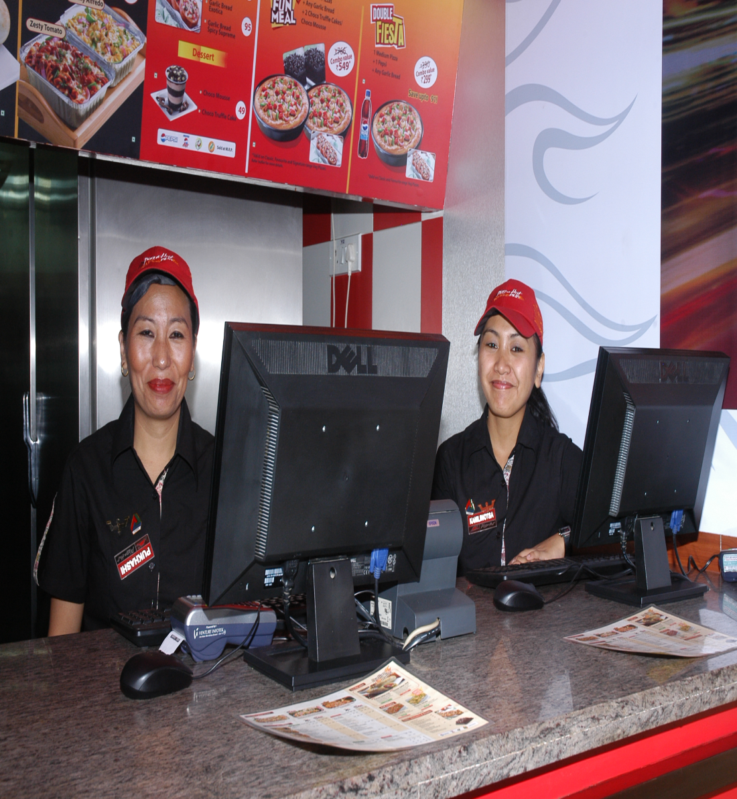
What is ‘Friend on the Inside’?
=
Customer’s Friend
Pizza Hut CSR
Notes:
ASK -
1. What does this statement mean?
2. How will this impact our team and customer?
GET RESPONSE –
We want all customers to believe that a Pizza Hut CSR is their friend. The CSR constantly looks at doing things which are in the customers best interest.

Slide 56
What are the behaviors of a ‘Friend on the Inside’?
1. Recognition of customer
& order preference.
2. Start conversations.
Example -
a. How are you?
b. Great to see you again
3. Suggest food and meal
bundles that provide
customers high value
What other behaviors can CSR’s display?
Notes:
DISCUSS –
What are the tools that help us in recruiting and training our CSR’s?
What are the personality traits of a ‘Friend on the Inside’?
How do we nurture and encourage CSR’s who display the right behavior?

Slide 57
What is value?
Value = Variety
Value = Quality
Value = Abundance
Value = On time service
Value = Pricing
How can we provide value to every customer?
Notes:
Reiterate – “What is cost of a happy customer?”
SAY- It is important to assess the various meaning of the word ‘value’. For different customers value is perceived differently. Take the example of a person who rides a Pulsar vs. a person who rides a Harley Davidson. If both were given the same riders jacket, each of them will perceive the value of the jacket differently.
We cannot use the one glove fits all solution when we address value. It is important that managers and CSRs are able to talk and ascertain what customers may want and guide them to provide the best value

Slide 58
What are some ways to provide great value?
1. Recommend meal deals
2. Suggest sides that customers may not be aware of
3. Recommend the right quantity of food
4. Suggest value upgrades for magic pan consumers
What are some ways in which our CSR’s can become ‘Friends on the Inside?
Notes:
DISCUSS – What are other behaviors a friend on the inside would display while interacting with customers?

Slide 59
‘Friend On The Inside’- Role Play
Activi
vity
What should the CSR do in the
following scenario’s?
1
A group of 6 students order for
4 small Zesty chicken pizzas
2
A single customer orders for a
magic pan solo pizza
3
A group of 2 customers order for
A medium pan chicken tikka pizza
Notes:
SAY – Work in teams. The objective of this exercise is to come up with the best response a CSR could have to each of these customers, while offering value.
GET RESPONSE
Ans 1 – recommend magic pan non veg – set of 4 & 2 personal pan pizzas. Watch out for their budget give abundance
Ans 2 – beverage to wash down the flavor full magic pan pizzas. Suggest meal for 1. Give a complete meal experience.
Ans 3 – Add Rs 40 and get GB+ Pepsi (Fun meal for 2). Save Rs 70/- . Provide price point and abundance value.
SAY – It is important that we explain why we are making any recommendation. While sizzle words help, logic and value in price, abundance and variety need to be explained. This will ensure that customers are aware that we are looking out for their best interest.

Slide 60
What is thing a ‘Friend On The Inside’ should NOT DO?
Never sell more than what a customer needs.
Customers who get great value will come to pizza hut many more times
Notes:
ASK- What are some of the phrases we should avoid while serving customers?
GET RESPONSE
That’s not what you ordered.
Our policy says……….
We’re not allowed to.
You’ll have to call back and talk to my manager
That’s the way we do it…
No, we cannot… … …
We are working on it. . …

Slide 61
Maximizing Sales In Delivery
5.
Measuring
Results
4.
Local Store
Marketing
1.
Understanding
Sales
3.
Maximize sales outside the store
2.
Maximize sales inside the store
Notes:
SAY – This module is about how we can increase sales in our trade zone.

Slide 62
Maximizing Delivery Sales
A
trade zone
Delivery Map
Poding
Alpha Listing
Pod optimizer
B
LEAFLETTING
Leafleting activities
Do’s & Don'ts
Schedule
Accountabilities
C
TRACKING
Redemption Tracker
Penetration
Pod Ownership
Notes:
SAY – To build sales in our trade zone, it is crucial that we have all the tools and knowledge (database). The trade zone map, leafleting and tracking of our activities will give us the decisive advantage in this battle. Data on the trade zone is the starting point for all sales building activities .

Slide 63
Trade zone
Notes:
SAY - This is the first facet in building a successful ‘Own The Zone’ program for home delivery

Slide 64
What are the qualifications for a Pizza Hut delivery trade zone?
A
trade zone
1. Minimum 15k households
2. Desired Pizza Hut delivery customer profile
Why are these details important ?
Notes:
ASK- Why are these criteria important? How do they help us?
GET RESPONSE
The scientific approach on trade zone selection ensures we meet the target sales. Accurate site selection insures we have potential in the trade zone. The 15k household is overall requirement. Many trade zones have a mix of residential and corporate households.
There also needs to be a healthy mix of customer profile.
Customer profile is done by the SEC – Socio Economic Class.

Slide 65
What information is required in a trade zone map ?
A
Delivery Map
trade zone MAP
1. Location of our store
2. 6 (+2) minutes drive time boundaries
3. Pod boundaries
4. Drive time bands
5. Location of competitors
6. Prominent buildings & traffic generators
Why are these details important ?
Notes:
ASK- Why is the map important?
GET RESPONSE
This information is the foundation of all BTL activities. Without these details we cannot make a successful battle plan. Lack of accurate data will lead to poor planning and execution with poor results.

Slide 66
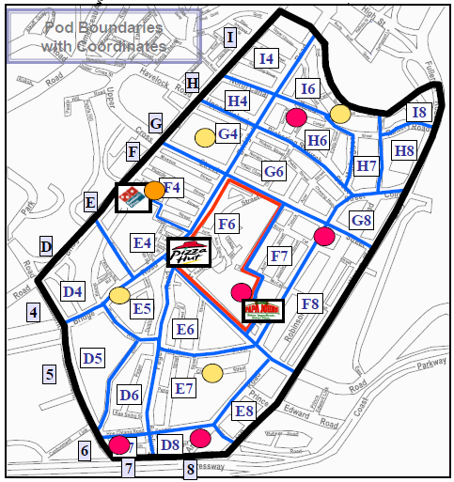
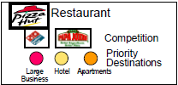
trade zone Map
Notes:
DISCUSS
How a trade zone is formed.
Drive in all directions for 6 minutes (2 minutes for vertical heights).
Draw concentric circles for 2, 4 and 6 minute drive times.
How can one indicate drive times
Color code the drive times. Pods with 2 drive time bands need to be slotted in the drive
time band that the majority of the pod falls into.
How do we divide the trade zone into pods
2 mins drive between any 2 areas in the pod
Use natural boundaries to divide pods – main roads, bridges, railway crossing ….etc.

Slide 67
What is a pod?
A
trade zone MAP
Poding
1. Small segments of the trade zone (2min drive)
2. Reflect natural and physical boundaries
3. Represent the source of our business
Why is podding important ?
Notes:
ASK - Why are pods important? How does pod help in our quest for trade zone ownership?
GET RESPONSE
Pods indicate the source of our business
Pods help us identify various customers and their needs.
Pods help us customize our strategy and approach to BTL and LSM activities.
Behavior of any pod to various offers help us understand the need of our customers in the trade zone.

Slide 68
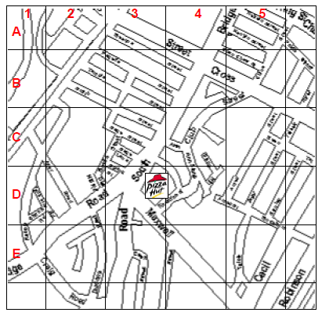
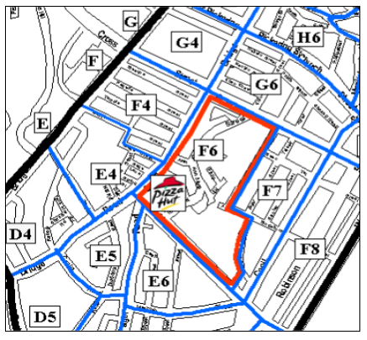
Gridding Vs Poding
Gridding
Poding
Notes:
ASK - What is the difference between grids and pods.? What is the more effective way of dividing our trade zone?
GET RESPONSE
Grids are 1/8 mile square portions of the trade zone.
Pods are divided by natural boundaries within 3 mins of each other.
Grids do not clearly indicate areas and localities
Pods have unique customer profiles
Pods are a more scientific means of splitting our trade zone.
ASK - How often should we refresh the map?
GET RESPONSE
Every 6 months
Every time we add or remove a pod.

Slide 69
What is alpha listing and hard coding?
A
Alpha Listing (Hard coding)
Trade zone MAP
Alpha Listing
=
List of all streets & prominent buildings for a pod in alphabetical order
Hard Coding
=
Every office, residence & institution on each street in each pod.
Why is alpha listing important ?
Notes:
ASK - Why are ‘alpa listing’ and ‘hard coding’ important?
GET RESPONSE –
We need to know where our customers order from.
With this knowledge we can ensure that every customer in the trade area receive a leaflet.
Hard coding is like a blue print of the trade area. It helps us plan our BTL strategy.

Slide 70
What is alpha listing ?
A
Alpha Listing (Hard coding)
trade zone MAP
Alpha Listing
  Name of locality, road, building
  Drive time
  POD number
  Hot/ Warm/ Tepid
Why are these details important ?
Notes:
ASK- Why is alpha listing important?
GET RESPONSE
Knowledge of all areas and buildings help us reach the customers faster. They also provide a broad understanding of our trade zone and helps in planning marketing activities.

Slide 71
What is Hard coding listing ?
A
Alpha Listing (Hard coding)
Additional Data
trade zone MAP
RWA INFO
Society Name
Society Secretary
House Number
Phone Number
Hard Code Data
  Building Name
  Number of Wings
  Number of HH
  Inaccessible HH’s/ Localities
CORPORATE INFO
Secretaries Name
Designation
Phone Number
Email id
Why are these details important ?
Notes:
ASK- Why is ‘hard coding’ important?
GET RESPONSE
Detailed records of all potential societies & corporate offices help us in ensuring we are able to develop a accurate and well targeted sales plan. The more we know the better our ability to make it ‘ ESPECIALLY FOR OUR CUSTOMERS’.
ASK- Do you think we have accurate data of all dwellings in each of the trade zone?
GET - Commitment on timelines to refresh alpha listing and hard coding for all areas.
Share timelines with operations leader

Slide 72
What is a Pod optimizer?
A
Pod Optimizer
trade zone MAP
1. Analyses pod potential
2. Calculates pod wise leaflet requirement.
3. Is the foundation on which all BTL activity is planned
Why is the pod optimizer important ?
Notes:
ASK – What is a pod optimizer?
GET RESPONSE-
This tool help us understand how many household are there in our trade area and uses a scientific method to arrive at the potential of each household. This then helps us in targeting areas where we need to leaflet to motivate customers to order with us.
The pod optimizer helps us to “fish where the fish are”.

Slide 73
What information do you need to make the pod optimizer
A
Pod Optimizer
trade zone MAP
A. POD Co-ordinates
B. Number of Households
C. Drive time
D. Drive time band
E. Sales
F. Competition
G. RGM Priority
Notes:
ASK-
1.Where do we get this information from?
2. How often do these number change?
3. How often should we ideally change these in the pod optimizer?
DISCUSS

Slide 74
What information do you need to make the pod optimizer
A
Pod Optimizer
trade zone MAP
D. Drive Time Bands
    0 – 2 Mins - 6 points
    2 - 4 Mins - 4 points
    4 - 6 Mins - 2 points
    6 - 8 Mins - 0 points
Why are drive time bands important ?
Notes:
ASK- Why are drive time bands significant?
GET RESPONSE
Maximum potential in any trade zone is nearer to the stores location.
The customers staying near the store have more brand recall
Service times are better

Slide 75
What information do you need to make the pod optimizer
A
Pod Optimizer
trade zone MAP
E. Sales Band
    Top Txns- 3 points
    Avg Txns- 2 points
    Low Txns- 1 points
Why are sales bands important ?
Notes:
ASK- Why do we do sales bands for our various pods?
GET RESPONSE
Higher the transactions, the higher the chance of growing transactions.

Slide 76
What information do you need to make the pod optimizer
A
Pod Optimizer
trade zone MAP
F. Competition Band
    National Chain 3 points
    Local chain 2 points
    No competition 0 points
Why is competition banding important ?
Notes:
ASK – Why is competition banding important?
GET RESPONSE
Professional and competent brands use scientific means to locate sites for delivery restaurants. The pods in which these stores are located will have a higher chance of ordering with the competition.

Slide 77
What information do you need to make the pod optimizer
A
Pod Optimizer
trade zone MAP
G. RGM Priority
    High 6 points
    Medium 4 points
    Low 2 points
    No go 0 points
    What do you base priorities
    on?
    Average Check
    Customer profile
    Competitor Activity
Why is RGM priority important ?
Notes:
ASK – Why is RGMs priority important?
GET RESPONSE
RGMs are the business leaders of their trade zones.
RGMs get first hand insights of pod potential.
They get to know of any change in trade zone dynamics.

Slide 78
Pod Optimizer Calculator
H. Total:
=Drive time + Sales + Competition +RGM
Score:
= Total
  4
Notes:
ASK -
Why do we divide the total of all scores by 4?
Which of these factors have more weightage?

Slide 79
Pod Optimizer Calculator
J. Priority:
  3 & more Hot
  2 to 2.99 Warm
  1 to 1.99 Tepid
  <1 Cold
Notes:
ASK – How has the priority of various pods changed after launching Magic Pan, our value initiative?
DISCUSS
SAY- It is important to review the sales parameter on the pod optimizer as often as possible, especially soon after we launch a value initiative or run an aggressive LSM offer.

Slide 80
Pod Optimizer Calculator
Notes:
ASK - How often should we make the pod optimizer
GET RESPONSE
Every 3 months
Any time one of the 4 key factors change.

Slide 81
What is the out come of the Pod Optimizer
K. # of leaflets per HH per month:
  Hot 2
  Warm 2
  Tepid 0
  Cold 0
L. # of leaflets per pod per month:
  Hot 2 X HH in Pod
  Warm 2 X HH in Pod
  Tepid 0 X HH in Pod
  Cold 0 X HH in Pod
How do we use the pod optimizer to increase sales ?
Notes:
REVIEW –
Understanding on all factors influencing the pod optimizer.
Importance of pod optimizer as a planning tool.
STOP & REVIEW POD OPTIMIZER – Reiterate frequency of updating – minimum every 6 months

Slide 82
Leafleting
Notes:
SAY - This is the second facet in building a successful ‘Own The Zone’ program for home delivery.

Slide 83
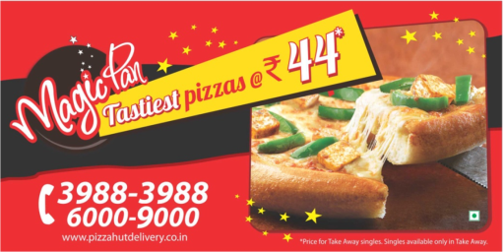
What are the various leafleting activities?
B
Leafleting
Leafleting Activities
DOOR TO DOOR
Left & Right
Mass Leafleting
NPI
Corporate
Notes:
ASK-
Why do we use many means to send leaflet to each and every customer?
Are there any other means to ensuring leaflets reach the customer?
GET RESPONSE
All guns to be fired to win the trade zone battle. The given list is indicative and not exhaustive. The objective is to ensure every customer residing in a HOT or WARM pod receives a leaflet twice in a month.
DISCUSS - ways and means to reach leaflets to the customers door step.

Slide 84
How is door to door leafleting done?
B
DOOR TO DOOR
Leafleting
Leafleting Activities
1. 2-3 riders to be scheduled for this activity
2. Each rider can do 60-90 leaflets per hour
3. Riders are scheduled for 60-90 minutes
4. Leaflets are dropped by the team -
Slipped under the door
b. Posted in the letter box
5. Leafleting team to be attired in full uniform
6. Cover all HOT & WARM pods
7. Display leaflets on RWA notice board
Notes:
SAY- Door to door leafleting is the most impactful of all the forms of leafleting.
This is also the most economical way of doing leaflets. We currently spend over Rs 5 cores in printing leaflets.
A 20% saving in leaflet printing cost can translate to one months extra month of TVC.

Slide 85
How is door to door leafleting done?
B
DOOR TO DOOR
Leafleting
Leafleting Activities
Ideal Timing -
  *Weekdays - 4:30 pm - 6:30 pm
*Weekends – 9am – 11 am/4:30pm – 6:30pm
Hot Pods
Warm Pods
Frequency | 2 times in a month
When
Thursday | 4- 6 min drive time pods
Friday, Saturday & Sunday | 2-4 min drive time pods
Type of leaflet | Regular or Monster leaflets
Frequency | 2 times in a month
When
Thursday | 4- 6 min drive time pods
Friday, Saturday & Sunday | 2-4 min drive time pods
Type of leaflet | Regular or Monster leaflets
Notes:
ASK – What are the advantages and disadvantages of door to door leafleting.
GET RESPONSE
This is the most effective way of leafleting. Door to door leafleting ensure that the leaflets reach only those pod we want and wastage is minimal.
Disadvantage is that due to restrictions in entering some societies, we may not reach all the households through this method of leafletining.

Slide 86
How is left & right leafleting done?
B
Left & Right
Leafleting
Leafleting Activities
1. Who – all riders
2. When – on every order
3. What is to be done – drop leaflets into neighboring household while on delivery
4. Riders to be briefed to carry 2 additional leaflets
while leaving the outlet for a delivery
Why do we do left & right leafleting?
Notes:
ASK – What is the purpose of left & right leafleting?
GET RESPONSE
Every time the rider is on a delivery, he can drop leaflets to the neighboring homes. This is an effective way to reach household in those societies that have restrictions on entry and door to door leafleting cannot be done.

Slide 87
How is Mass leafleting done?
B
Mass Leafleting
Leafleting
Leafleting Activities
1. To be done in hot pods within 4 mins drive time
2. 8-10 riders lead by a manager, scheduled on Saturdays between 9 & 11am
3. Mass leafleting to cover 2000 or more HH
4. Leaflets are dropped by the team -
Slipped under the door
b. Posted in the letter box
5. Make note of all dwellings where entry is restricted
Notes:
ASK – What is the purpose of mass leafleting.
GET RESPONSE
This ensures we reach a large number of households and is an effective way of building sales during weekends , during festivals, cricket match days and during other national and local holidays.

Slide 88
How is NPI done?
B
NPI
Leafleting
Leafleting Activities
1. Inserting leaflets into news papers at the hub
2. 3-4 riders & a managers to conduct this activity on Fridays or Sundays.
3. NPI to cover 1500 to 3000 HH
4. Monitor the insertion of leaflets
5. Make note of all dwellings where entry is restricted
Notes:
ASK – What are the advantages and disadvantages of NPI’s
GET RESPONSE.
Advantage – Can cover a large number of household and helps us get our leaflets to those societies where entry is restricted.
Dis-advantage –high wastage of leaflets as not all of them reach the targeted households. Leaflets also tend to go to some of the areas which are outside the trade area leading to unproductive calls at the call center.

Slide 89
How to leaflet corporate office ?
B
Corporate
Leafleting
Leafleting Activities
1. Hand leaflets to the reception
2. Distributing leaflets at the entrance
3. Direct mailer of leaflet to corporate customers on data base
4. Hand over leaflets while on delivery to offices
What are the various ways to do leafleting in corporate office?
Notes:
ASK – What are other ways of ensuring leaflets reach the customers at offices within the trade zone?
Share best practices

Slide 90
Leafleting do’s and don’t
B
Leafleting
Do’s and Don’ts
DO’S
DONT’S
Plan all leafleting activities.
Leaflet to be dropped by the team
Leafleting team to be attired in uniform
Carry the correct amount of leaflets
Track pod wise redemptions
Track leaflet stocks
Contact RWA to gain entry
Hand leaflets to building security guards
Ring the bell at residences
Do not carry more leaflets than can be leafleted.
Do not use torn or damaged leaflets
Do not leaflet more than 3000 leaflets in a day
Notes:
SAY- The do’s and don’t are important to protect our brand against any form of litigation.
Pizza hut is a brand own for quality. It is important that the brand is displayed in a way that denotes quality.
Please check with you area coach, market manager and involve Yum marketing for high quality branding solutions.

Slide 91
Principles of making a leafleting schedule
B
Leafleting
Schedule
Schedule to be made
for a month
20% NPI, 80% Door to
door & Mass leafleting
NPI on Friday & Sunday
2 leaflets per HH in Hot
& Warm pods
Mass leafleting in HOT
pods every Saturday
Notes:
ASK – What information is available in the leafleting schedule.
GET RESPONSE –
Day & date
Time for leafleting
Pod number & name
Leafleting team
Total leaflets
Total households in the pod

Slide 92
RGM Accountability
B
Leafleting
Accountability
1. Follow leafleting game plan
2. Schedule Riders as per leafleting game plan
3. Personally lead leafleting execution
4. Personally conduct NPI
5. Send Photos of each NPI/Leafleting conducted.
6. Conduct random call backs to customers in pods
where leafleting is completed
Notes:
ASK – Why is it important for RGM’s to be part of the leafleting activities?
GET RESPONSE-
It is important for RGMs to be a part of leafleting. Its an opportunity to bond with the delivery team and send a very clear message to the team on the importance of leafleting. RGMs will get first hand information on buildings where entry is restricted.

Slide 93
Area Coach Accountability
B
Leafleting
Accountability
Conduct 2 single agenda visit in a month to
check efficacy of leafleting
2. Conduct NPI surprise check per week &
recognize or coach store teams.
3. Schedule oneself for 1 leafleting activity per
week
4. Personally conduct call backs to low redemption
pods
5. Share photos of NPI & Leafleting conducted
Notes:
ASK – Why is it important for Area Coach to be part of the leafleting activities?
GET RESPONSE-
It is important for area coaches to know what is working well and areas of opportunity when it comes to BTL activities. When an area coach is monitoring any activity, the team will ensure that they put their best foot forward.

Slide 94
Tracking
Notes:
SAY - This is the third facet a successful ‘Own The Zone’ program for home delivery. Daily and periodic tracking is important to understand the effectiveness of BTL activities undertaken by the store team. The tracking helps RGMs in taking corrective action in case BTL activities are not yielding the desired results

Slide 95
What is redemption ?
C
TRACKING
Redemptions
    Redemption = Orders received after any leafleting activity
    Effective leafleting leads to
    high redemptions
Why is tracking redemptions important ?
Notes:
ASK – How do we track redemption? How does redemption impact the RGM’s
GET RESPONSE
Redemption is tracked on the basis of pod wise transactions.
High redemptions indicate effective leafleting.
Low redemption could be due to poor and ineffective leafleting.
Poor redemption should result in RGMs reviewing effectiveness of leafleting or change in the offers and meal deals.

Slide 96
What is penetration ?
C
TRACKING
Penetration
    Penetration
Active data-base
=
X
100
House Holds
    Penetration is tracked for
    a. The trade zone
    b. The pod
Why is tracking penetration important ?
Notes:
ASK – Why is penetration important to track?
GET RESPONSE
This number shows us the number of customers who have ordered with pizza hut. This is the data base we have to plan BTL sales activities.
High penetration shows that we have a large number of customer who have used pizza hut service in our trade zone.
Example - In case there are 2000 households in a pod and 500 of them are on the active database, the penetration figure for the store will be 25%

Slide 97
What can increase penetration ?
C
TRACKING
Penetration
    What do we do in the following
    situations?
    Low Penetration in a Warm
    Pod
    Low Penetration in a Hot
    Pods
What are ways by which we can increase penetration?
Notes:
ASK – What is the action that an RGM should take based on penetration data?
GET RESPONSE
Protect Hot pods. Increase penetration by targeting households that have not ordered or order infrequently.
Increase penetration in warm pods. Convert warm pods to hot by adding new customers. .

Slide 98
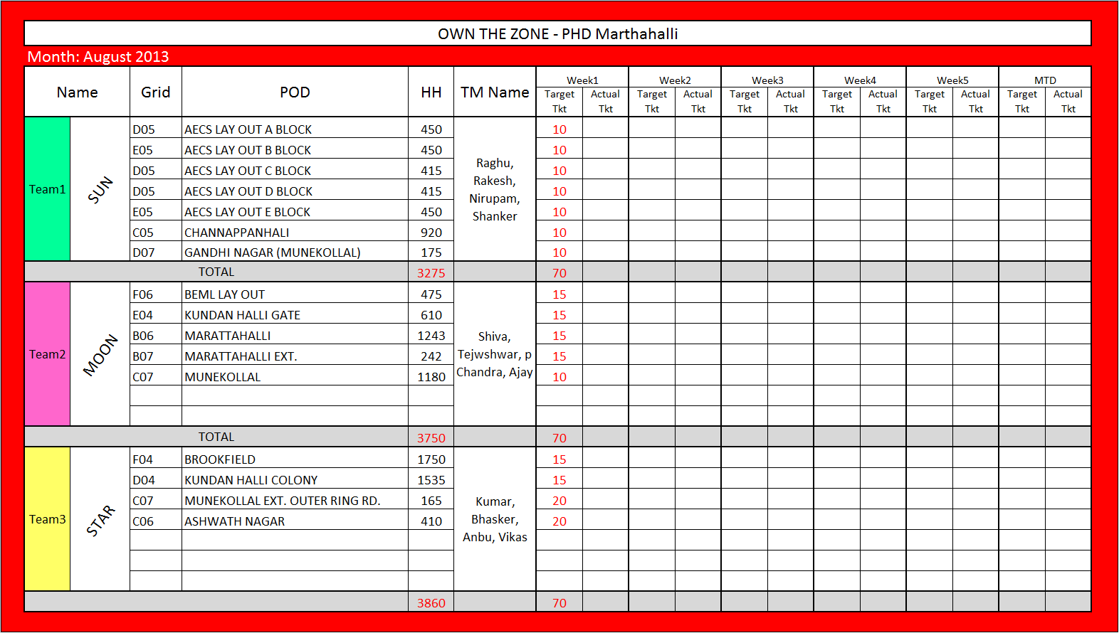
What is the pod ownership program ?
C
TRACKING
Pod Ownership
Assign Team to own
each pod
2. Each team is given a
target of transaction
to be achieved
3. Use the tracker & share
results
4. Incentivize pod winners
& coach outliers
Why is pod ownership important ?
Notes:
ASK – Why is the pod ownership program important?
GET RESPONSE
This program helps build the ‘Own the Zone’ mentality among team members by incentivizing additional delivery transactions. This is a Win-Win situation where both the team member and the brand benefits.

Slide 99
Pod Ownership Program Dynamics
1. Each additional transaction generated is worth Rs 10. Use previous 3 months average pod transactions
2. Each member of the team has to part of the leafleting activities scheduled for the period
3. RGM to have done random checks and call backs to check on leafleting effectiveness
4. Pod-wise redemptions to be updated on a daily basis
Notes:
SAY – Here are some guidelines to lead a successful Pod Ownership program.

Slide 100
Pod ownership program
C
Activi
vity
TRACKING
Pod Ownership
Team Members | Station
Dinesh | FOH
Satendar | BOH
Krishna | BOH
Brijesh | Rider
Neha | FOH
Vikas | Rider
Pradeep | Rider
Vivek | BOH
Ajay | BOH
Vikram | FOH
Pritam | Rider
Kapil | Rider
Pod ID | Avg. Monthly Txn
D-01 | 117
A-03 | 543
D-03 | 377
C-07 | 84
A-06 | 191
D-05 | 137
B-03 | 19
B-04 | 172
C-05 | 505
Using the data
provided create
a. Pod ownership
teams
b. Assign targets to
each team.
The store transaction
growth target is 12%
Notes:
DO NOT SHARE THE ANSWERS UNTILL THE ACTIVITY IS COMPLETE
Current total transactions - 2145
12% Growth - 2402
SAY- Work in team to complete this activity. Using the data given on these sheets (distribute hand-out) plan a successful pod ownership program.

Slide 101
Pod ownership program
C
Activi
vity
TRACKING
Pod Ownership
Results at the end
of the month
Other Information
Pod ID | Txn Achieved
D-01 | 86
A-03 | 573
D-03 | 512
C-07 | 108
A-06 | 227
D-05 | 124
B-03 | 34
B-04 | 225
C-05 | 617
Brijesh was on annual leave during this
period.
Leafleting was not done on 3 days due to heavy rains
BOGO offer was done in D03 with 8% redemption.
Notes:
SAY- Consider the new pod wise transaction data and the other information provided.

Slide 102
Pod ownership program
C
Activi
vity
TRACKING
Pod Ownership
1. Calculate absolute increase in transactions.
2. Calculate percentage increase in transactions.
3. Calculate total incentive payout
4. Calculate sales increase if APC was constant @ Rs 512
5. What was the ROI on the incentive.
Notes:
SAY – Using the data provided please give answers to these questions. Teams get points for speed & accuracy.

Slide 103
Pod ownership program –
Answers
C
Activi
vity
TRACKING
Pod Ownership
1. Calculate absolute increase in transactions. Ans – 361 Txn
2. Calculate percentage increase in transactions.
Ans – 17%
3. Calculate total incentive payout.
Ans Rs 3610
4. Calculate sales increase if APC was constant @ Rs 512. Ans- Rs 184132
5. What was the cost of the incentive (in percentage). Ans – 2% of additional sales
Notes:
SAY – Please find the correct answers to the questions.
ASK – What are the benefits of the pod ownership program?
STOP & REVIEW LEAFLETING PRINCIPLES & POD ONWERSHIP

Slide 104
LSM in action
5.
Measuring
Results
4.
Local Store
Marketing
1.
Understanding
Sales
3.
Maximize sales outside the store
2.
Maximize sales inside the store
Notes:
SAY- This module gives us guidelines on which offers we need to choose based on the opportunities known to us. LSM in action also facilitates in evaluating the financial viability off offers.

Slide 105
Before doing LSM
Hygiene factors
1.
Store Capacities
Staffing + Bikes + Equipment
+ Small ware
2.
Audit Scores is on or above target
CMS + CER + SAFETY
3.
Trained Team
Fully Trained management
and store teams
Do not proceed in case one or more of the above
factors are not met
Notes:
ASK- What are the basic hygiene factors that need to be in place prior to the deployment of any LSM plan?
GET RESPONSE
Build capacities and ensure all equipment is working well.
ASK - Why are these aspects important?
GET RESPONSE
If customer receive poor service they will be
disappointed. An irate customer will complaint. He/she
may not complaint and not order with us again

Slide 106
LSM in action
4 levers & tools
Assess viability
Tactical programs
Taking it to the team
Measure Results
Notes:
SAY- there are 5 critical aspects of LSM in action. We will dwell into each of them during the course of this module.

Slide 107
4 levers & tools
Assess viability
Tactical programs
Taking it to the team
Measure Results
Notes:
SAY- There are 4 levers available to the RGM . The RGM can choose from one or more of these to build sales. Each lever addresses a particular sales opportunity.

Slide 108
4 levers with the RGM
APC
New Customers
Frequency
Reactivate
Lapsers
Transactions
Tools for each lever
Notes:
SAY- There are transaction drivers and APC builder. Let us take a closer look at what tools are available to address each of these 4 levers.

Slide 109
4 levers with the RGM
APC
New Customers
Frequency
Reactivate
Lapsers
Tools for each lever
Notes:
SAY- lets look at some of the APC building tools

Slide 110
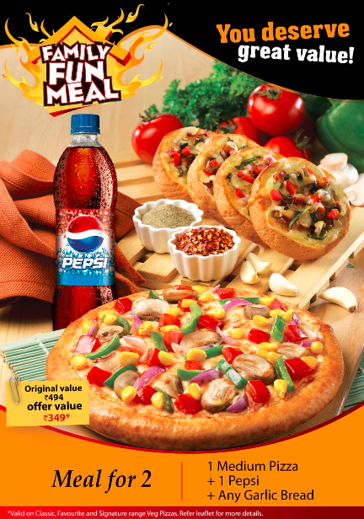
Tools for increasing APC
Sell more meal deals
How?
Cashier wise targets to be given
Increase visibility for customers at the till
Art work can be ordered
Notes:
ASK- How can meal deals help in improving APC?
GET RESPONSE
Meal deals offer abundance and value in pricing. Suggest meal deals through in store communication.
Discuss execution process

Slide 111

Tools for increasing APC
Sell xtra toppings, cheese
How?
Increase visibility for customers at the till
Art work can be ordered
Notes:
ASK – How can xtra toppings and cheese help sales?
GET RESPONSE
In the case of a value proposition, it is important to suggestive sell something on the menu which offers value in variety or abundance and take the price up marginally to ensure that the meal remains affordable.
Discuss execution process

Slide 112
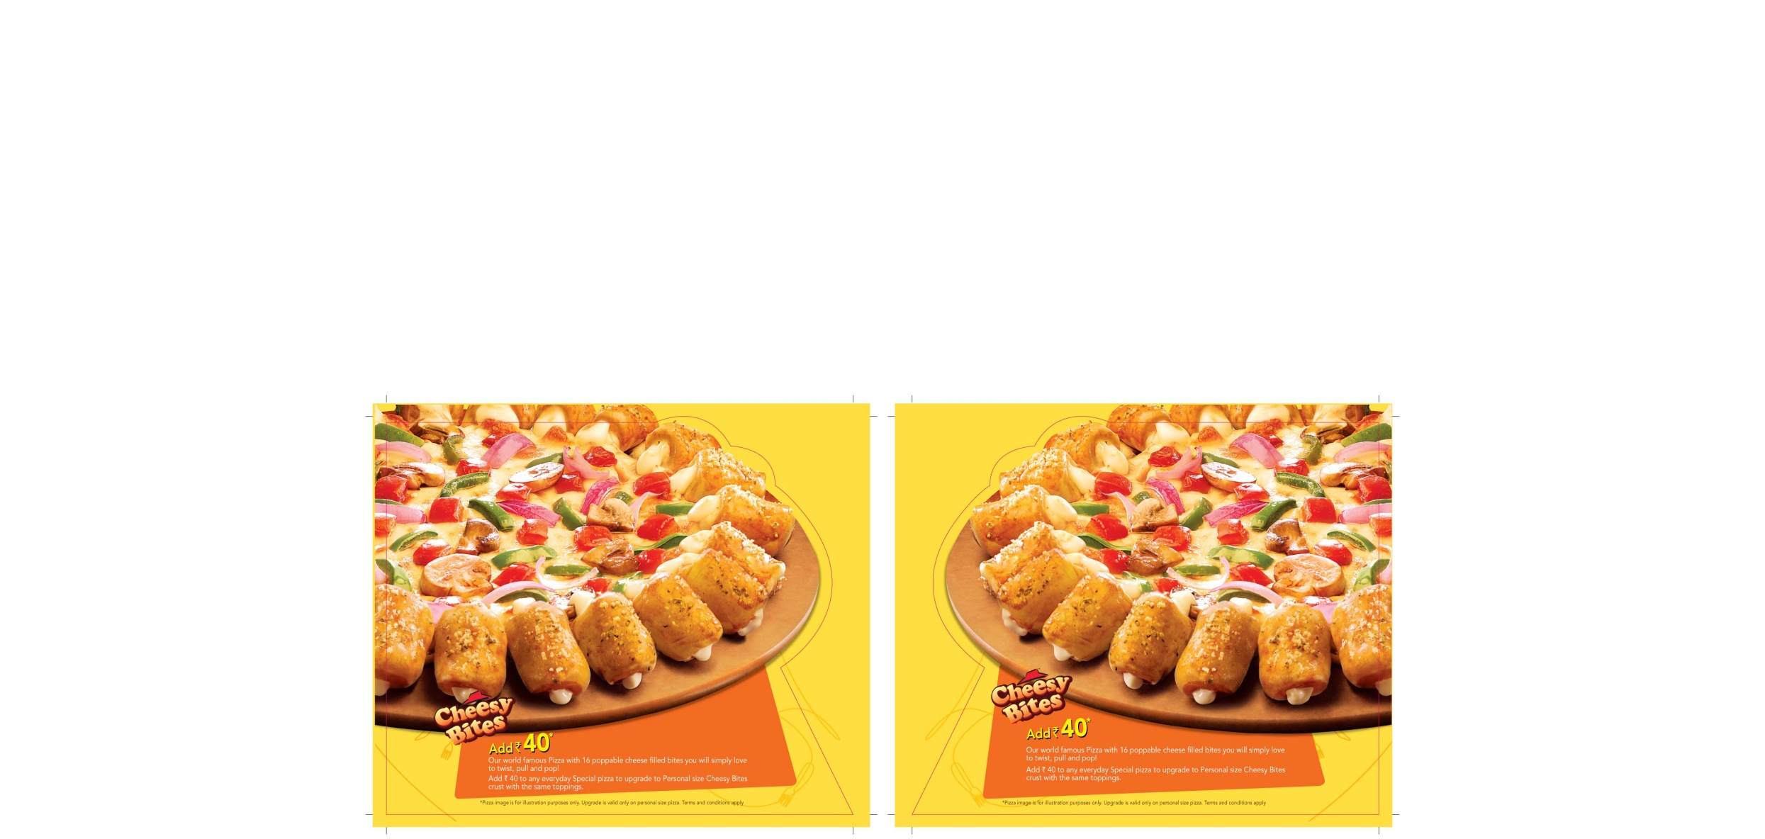
Tools for increasing APC
Sell/ trade up premium products
How?
Cashier wise targets to be given
Art work can be ordered
Notes:
ASK-
What is trade up?
How does selling premium pizzas help our sales?
GET RESPONSE
Trade up – to recommend a premium product to a customer.
Premium pizzas offer the customer the best of Pizza Hut’s innovations, and also
ensures we are able to improve APC.
Discuss execution process

Slide 113
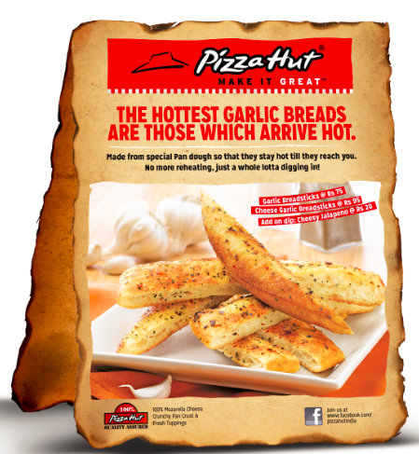
Tools for increasing APC
Increase items per txn
How?
Cashier wise targets to be given
Art work can be ordered
Notes:
ASK- How can we sell more items per check?
GET RESPONSE
Many customers are not aware of all side items on the menu. We regularly introduce new products and it is important to make customers aware of these new introductions.
Discuss CSR targets, incentive, other execution points

Slide 114
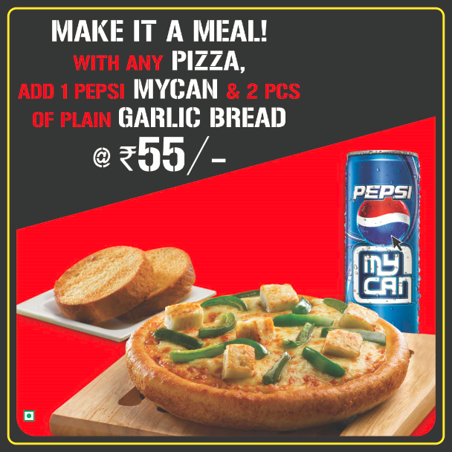
Tools for increasing APC
Increase items per txn
How?
Cashier wise targets to be given
Art work can be ordered
Notes:
ASK- How can we sell more items per check?
GET RESPONSE
One of the ways to ensure we sell more items per check is to build meal bundles which have 3 or more items. We can leverage in store marketing collateral to inform customers of meal bundles.
Discuss CSR targets, incentive, other execution points

Slide 115

Tools for increasing APC
Increase items per txn
How?
Cashier wise targets to be given
Art work can be ordered
Notes:
ASK- How can we sell more items per check?
GET RESPONSE
Variety in menu helps in increasing items per transaction. CSRs need to suggest sides or a meal bundle for every order.
Discuss CSR targets, incentive, other execution points

Slide 116
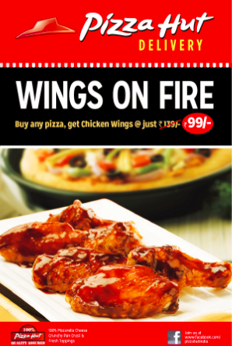
Tools for increasing APC
Increase items per txn
How?
Cashier wise targets to be given
Art work can be ordered
Notes:
ASK- How can we sell more items per check?
GET RESPONSE
It is important to use marketing collateral to sell sides which will improve our APC. A side which has a high menu mix will have a higher impact than a dish which has high pricing.
Discuss CSR targets, incentive, other execution points

Slide 117
4 levers with the RGM
APC
New Customers
Frequency
Reactivate
Lapsers
Tools for each lever
Notes:
SAY- lets look at some tools to attract in new customers

Slide 118

Tools for increasing New Customers
Acquire new customer
How?
Acquire through leafleting.
Art work can be ordered
Notes:
ASK-
How does this offer help in increasing new customer?
What are some of the key execution steps that are critical to attracting new customers?
GET RESPONSE
Historically BOGO has been our best performing offer. This offers adds on new customer
and increases frequency of existing customers. It is important that we use external marketing
collateral like leaflets or banners to bring in new customers.
Discuss leafleting plan and strategy. What is the most effective way of leafleting a BOGO leaflet. Are there any other ways of communicating a BOGO.

Slide 119
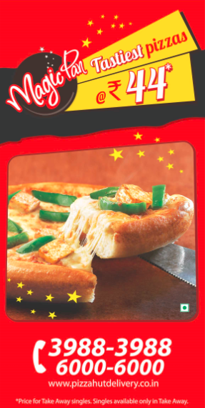
Tools for increasing New Customers
Acquire new customer
How?
To be displayed on store facade.
Art work can be ordered
Notes:
ASK-
How does this offer help in increasing new customer?
How can we ensure the offer drives new customers acquisition and does not cannibalize APC?
GET RESPONSE
Use external marketing collateral to increase transactions.
Discuss modes of communication

Slide 120
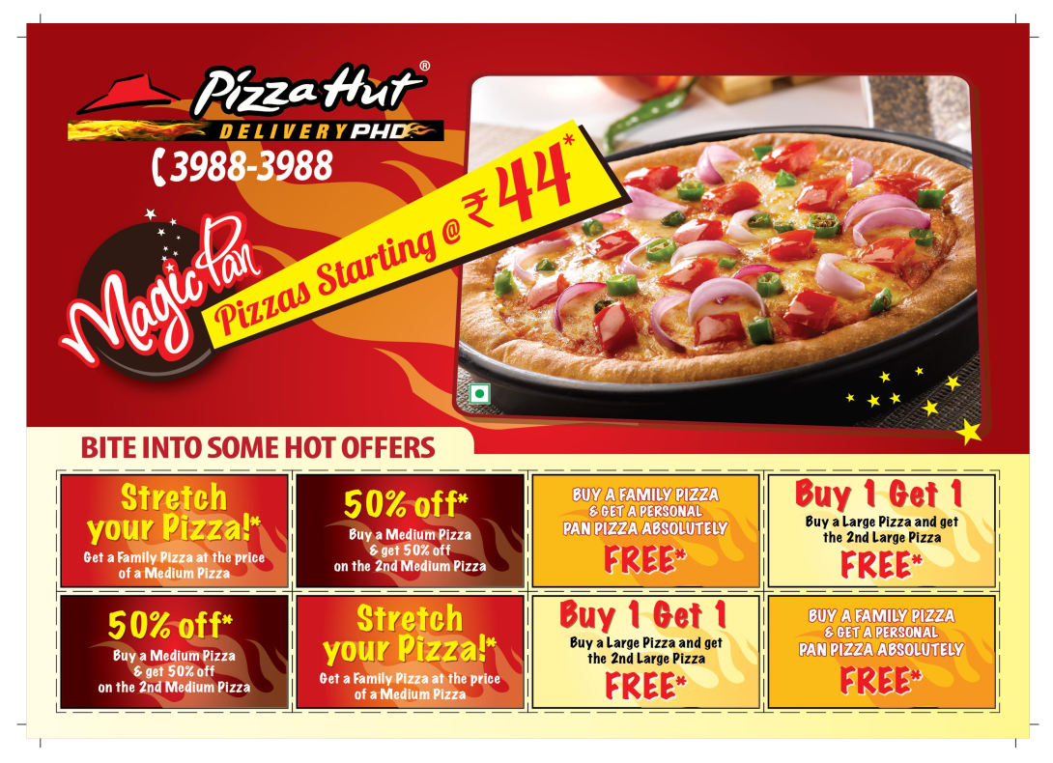
Tools for increasing New Customers
Acquire new customer
How?
Acquire through leafleting.
Art work can be ordered
Notes:
ASK-
How does this offer help in increasing new customer?
How can we ensure the offer drives new customers acquisition and does not cannibalize APC?
Discuss modes of communication
GET RESPONSE
The leaflet cover displays magic pan which is our value proposition. The coupons ensure that customers have the option of a la carte products while being able to avail discounts.

Slide 121
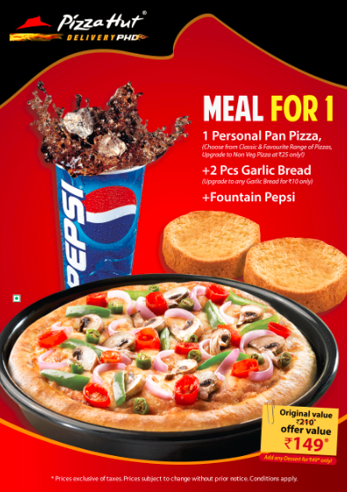
Tools for increasing New Customers
Acquire New Customers
How?
Increase frequency through mass leafleting
Art work can be ordered
Notes:
ASK-
How does this offer help in increasing new customer?
Discuss modes of communication
GET RESPONSE
This offer helps increase transactions in locations where there are individuals who come in for a meal. We need to ensure that we are advertising this offer outside the store through leaflets/banners/posters etc.

Slide 122
4 levers with the RGM
APC
New Customers
Frequency
Reactivate
Lapsers
Tools for each lever
Notes:
SAY- lets look at some tools to increase frequency of purchase.

Slide 123

Tools for increasing Frequency
Increase Frequency
How?
Increase frequency through bounce back offer.
Art work can be ordered
Notes:
ASK- How can this offer help in increasing frequency ?
GET RESPONSE
This offer a discount, which incentivizes the customer to re-purchase within a given date. The validity date is kept lower than the current customer order frequency.

Slide 124
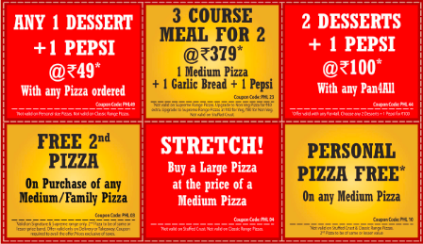
Tools for increasing Frequency
Increase Frequency
How?
Increase frequency through monster leaflets
Art work can be ordered
Notes:
ASK- How can these coupons help in increasing frequency ?
GET RESPONSE
Multiple coupons offer the customer flexibility in choosing the products of their choice while offering value through discounting.

Slide 125
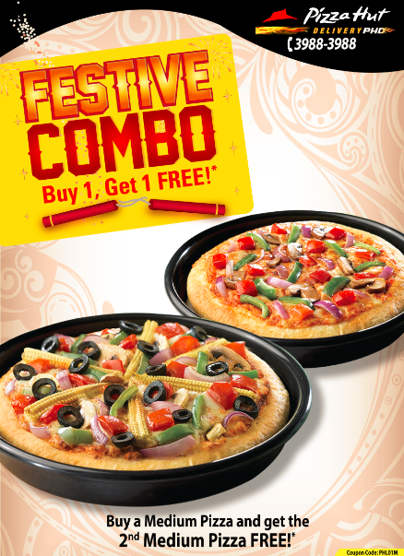
Tools for increasing Frequency
Increase Frequency – Special occasion offers
How?
Increase frequency through mass leafleting
Art work can be ordered
Notes:
ASK- How can BOGO during festivals help in increasing frequency of orders ?
GET RESPONSE
Festivals and holidays are occasions when families are likely to order from outside. A strong offer like a BOGO will ensure that the customers chooses Pizza hut over our competitors.
Festivals are also good occasions to build a brand connect with society.

Slide 126
4 levers with the RGM
APC
New Customers
Frequency
Reactivate
Lapsers
Tools for each lever
Notes:
SAY- Re-activation of lapsed customers is the 4th lever that the RGM can trigger to grow transactions and sales.

Slide 127

Tool for re-activating lapsers
Winning back lapsers
How?
Increase frequency through direct mailers
Art work can be ordered
Notes:
ASK-
How do we reach out to lapsed customers?
What offers should we give to win back lapsed customers?
3. What is the importance of re-activation of lapsers?
SAY- While we know that lapsed customers will respond only to very attractive offers, calls back and direct interaction will always lead to higher redemptions.

Slide 128
3 Key Sales Drivers
Transactions
Ticket Average
Customer
Connect
&
Brand
Awareness
New users
Items per bill
Local Promotions
Visit frequency
Group size
Special Occasion
BUILD
BUILD
ENHANCE
Notes:
SAY – There is a third driver to grow sales- building awareness and customer connect.
ASK- What are some of the activities that we do to build awareness and connect with customers.
GET RESPONSES –
Build Awareness – Now opening banners, directional leaflets/signage, etc
Customer connect – RWA sampling activities, customized posters/letters with offers for specific offices/collages/RWA’s.

Slide 129
LSM Bank
TRANSACTION
CUST CONNECT
& BRAND AWARENESS
Support National Initiatives
Day Part Boosters
Bounce back offers
Price Off offers
Refresh Awareness
TICKET
Suggestive selling
Trade up
Meal Bundle
Local Festival
Special Occasions (Birth days, Anniversaries)
New store open
Store locator
Notes:
SAY- Here are some of the ways to grow sales using ATL and BTL communication

Slide 130
LSM: Medium
Instore
trade zone
Mass Media
Leaflet
Emailer
SMS
FB promo
Sandwich Boards
Banner
Cross promo’s
In-mall branding
Cable TV
Digital/Online
Movie ticket jackets
Print AD
Hoardings
FB promo
Digital/Online
Menu board
Counter/Tent cards
Till cards
Standee
BB Voucher
Man Post
Ticket jacket
CSR Incentives
Notes:
SAY- Here are some of the ways to communicate any offer or share information with customers.
ASK - Are there any other means of communicating with customers

Slide 131
4 levers & tools
Assess viability
Tactical programs
Taking it to the team
Measure Results
Notes:
SAY- We have a few tactical tools that can be deployed to grow sales.
ASK- What are tactics?
GET RESPONSE-
Tactics are plans that can be deployed quickly to achieve desired results – Grow sales!

Slide 132
Tactical Programs
Celebration week
Corporate Sales
Notes:
SAY – There are 2 key tactical initiatives that we have to deploy in our trade zones to build sales.

Slide 133

Tactical tools
Celebration week
Corporate Sales
Notes:
ASK –What is celebration week?
SAY – Let us explore the celebration week mechanism

Slide 134
What is Celebration Week?
Objective
Intense week long acquisition drive
Focus on key trade zones.
How?
Attractive offers & step changed visibility
Expected Result
During CW: 2X ADS
Post CW: ADS 10-15% higher than regular
Bold Goal: Double Transactions for the week
Notes:
ASK- Which ABR tools are evident in the goals set?
GET RESPONSE-
Choose your mindset
Picture Step change
Shoot for the moon

Slide 135
What is Celebration Week
Which Store
All stores should execute Celebration Week
When
Minimum once in 6 months
Who
Area Coach + RGM + Store team + Additional Team members
Notes:
ASK- What additional resources are required to execute celebration week so that we are able to double our transactions in a week?
DISCUSS

Slide 136


Attractive Offers
Bounce Back offers
Many offers & various methods of distribution
Notes:
ASK- What is the purpose of bounce back coupons?
GET RESPONSE-
Entice customers who have been activated to order again within the next 30 days. Increase frequency.

Slide 137


Attractive Offers
Store Façade Banners
Many offers & various methods of communication
Notes:
ASK- What role does banners play?
GET RESPONSE-
Banner or decals on the exterior of the building are excellent ways to use our store facades to advertise. The advantage is that there is not additional cost apart from the cost of printing.

Slide 138

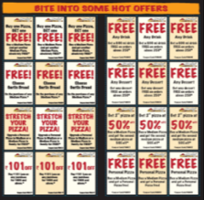
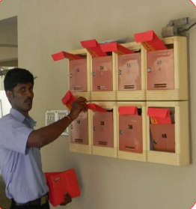
Attractive Offers
Direct Mailer
Many offers & various methods of communication
Notes:
ASK- What are some of the watch-outs while distributing direct mailers?
GET RESPONSE-
Hand deliver or use courier service. Direct mailers are expensive.
To be used only in hot pods.
Use it to re-activate lapsed customers.

Slide 139
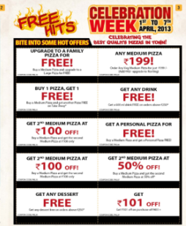
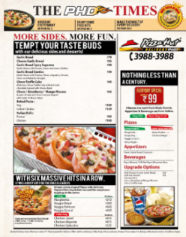

Attractive Offers
NPI Leaflets
Monster Leaflets
Many offers & various methods of communication
Notes:
ASK-
1.How many NPI’s need to be scheduled for a Celebration week?
2. How do we utilize monster leaflets to get the maximum redemption?
GET RESPONSE-
2 NPI’s during the week. All households to be targeted
Monster leaflets to be distributed through mass leafleting. Minimum 3 mass leafleting periods scheduled during the week.

Slide 140
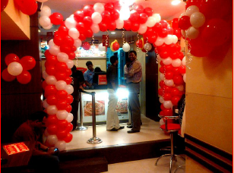
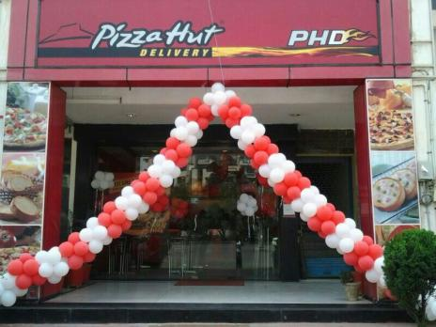
In Store Communication
Store to be decorated
Notes:
ASK- Why is it important to decorate the store?
GET RESPONSE – To indicate that there is a celebration taking place at pizza hut.

Slide 141
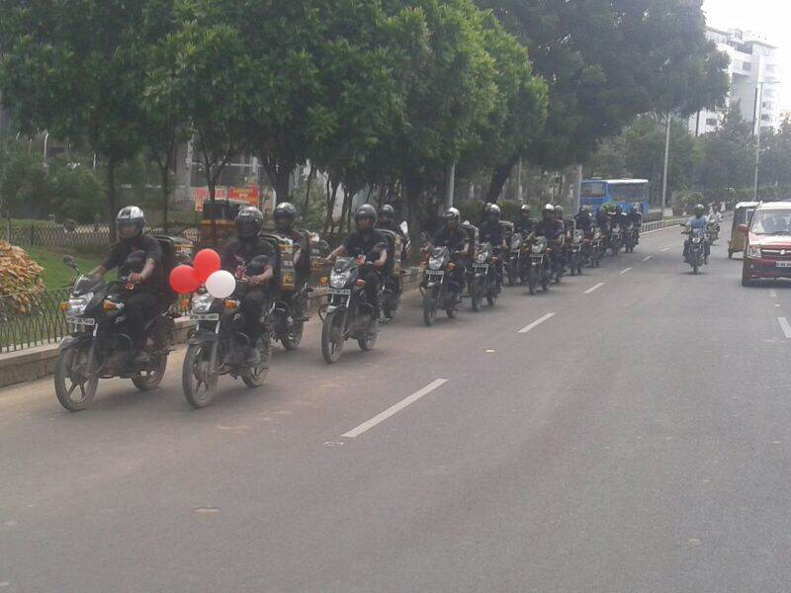
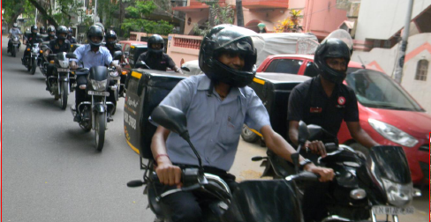
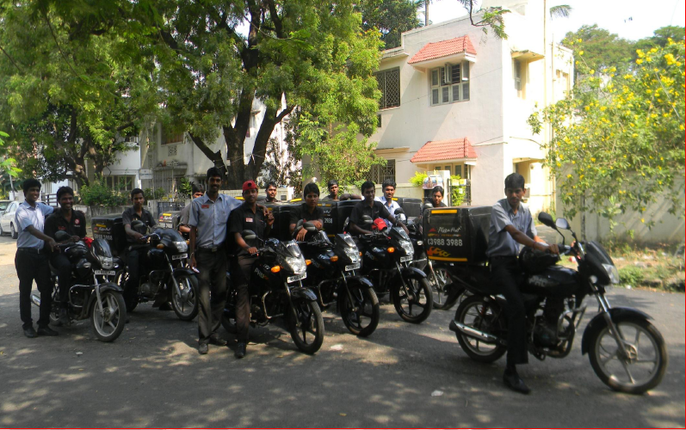
Step Changed Visibility in Trade Zone
Bike rally with 10-15 bikes
Notes:
ASK-
1. How many bike rallies should be done during celebration week?
2. Why is it important to conduct bike rallies?
3. What is the best way to get visibility while conducting a bike rally?
GET RESPONSE –
Minimum of 3 bike rallies during celebration week.
Disruptive visibility.
Minimum 10-12 bikes to be on the road. Bikes to be decorated. Riders to wear sandwich boards. Stop and distribute monster leaflets

Slide 142
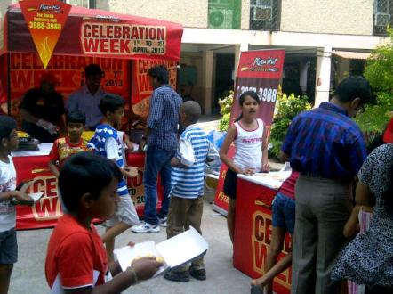
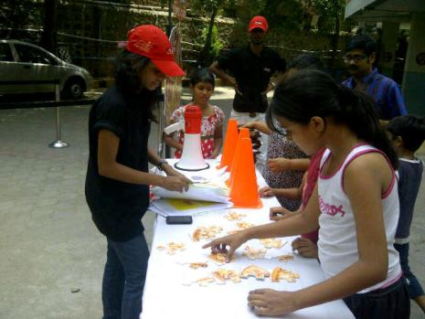
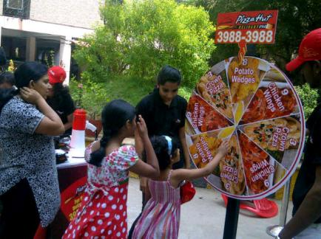
Residential society activities
RWA Activities with pizza sampling & database
acquisition
Notes:
ASK- Why is it important to conduct RWA activities?
GET RESPONSE – Residences contribute to the bulk of our sales. Activities where residents get to sample pizzas and win coupons by participating in games and activities help build awareness and customer connect.

Slide 143
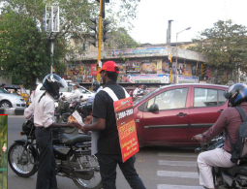
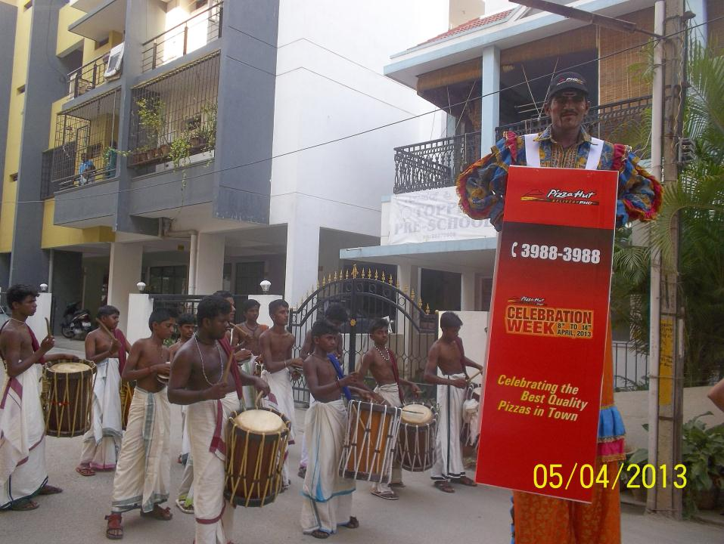
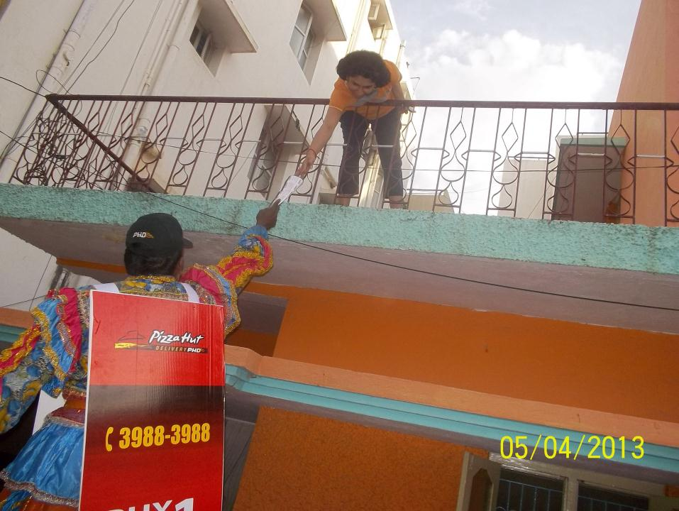
Stilt Walkers & Sandwich Boards
Stilt walkers and team members distribute leaflets
&
wear sandwich board communicating offers
Notes:
SAY- Here are some other ways to grabbing eye balls in the trade zone especially at traffic generators.

Slide 144
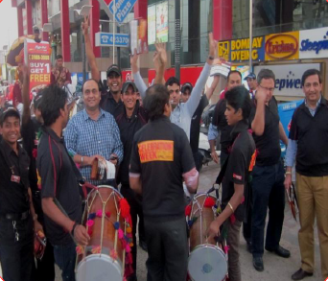
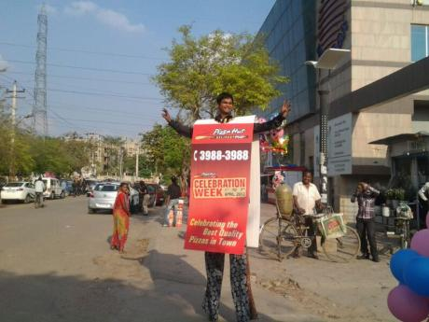
Disruptive communication
Notes:
ASK- Please share what activities have worked for you in your trade areas. Are there any disruptive activities that you feel we can include as part of celebration week?
ALLOW DISCUSSION

Slide 145
Celebration Week
Do’s
Don’t’s
Plan for CW a month in advance
Ensure IT update is done
Inform call center of start date
All marketing collateral to placed prior to start day
Store is decorated with red & white balloons
Minimum of 3 bike rallies during the week.
Customer data is collected for every interaction
Sampling to be conducted in underpenetrated RWAs
Use banners & sandwich boards to communicate offer in trade zone
Do not use blue or yellow balloons
Do not use A4 leaflets for NPI’s
Use horse carts/chariots to drive visibility.
Avoid using camels, elephants ,etc.
Don’t enter societies without the required permissions.
Notes:
ASK – Why are these do’s and don’ts important?
DISCUSS

Slide 146

Tactical Programs
Celebration week
Corporate Sales
Corporate Sales Strategy
Notes:
ASK –Why is corporate sales important?
GET RESPONSE-
Many of our trade zones have medium to large corporate offices. Corporate offices are a source of bulk orders and can be a powerful means to growing APC.
SAY – Let us explore our corporate sales strategy.

Slide 147
Corporate sales program
Objective
Building sales from offices and
businesses in our trade zone
How?
Build visibility & build patronage
Expected Result
Customers in corporates choose
pizza hut over other delivery brands
in the trade zone
Notes:
ASK – How are the needs of corporate customer different from that of a residential customer?
GET RESPONSES –
They have very limited time for lunch. In most cases, it would be a business lunch or part of a meeting.

Slide 148
Corporate Sales cycle key steps
Identify Opportunity
Gain Visibility & Incentivize
Step 1 Build database
Leaflets
Step 2 Gather information
Posters
Step 3 Visit process
E mailers
Discounts on Bulk orders
Discount for employees
Corporate discount deals
Notes:
SAY- Our objective is to build a relationship with all corporate offices in our trade zone and give them a reason to choose us over other brands.

Slide 149
Corporate Sales key steps
Identify Opportunity
Gain Visibility & Incentivize
Step 1 Build database
Leaflets
Step 2 Gather information
Posters
Step 3 Approach key
decision makers
E mailers
Discounts on Bulk orders
Discount for employees
Corporate discount deals
Notes:
SAY- Let us dwell deeper into the means by which we can indentify our corporate business opportunity

Slide 150
Identify Opportunity
Step 1
  List all major corporate in your area
  Tap into Map My India data
  Use hard coded pod data
Notes:
SAY- Corporate database is the vital starting point to building relationships with any company. Company name, profile and location is the first step.

Slide 151
Form categories based on opportunity
Step 2 (Gather information about companies)
  Employee count
  Drive time
  Presence of competition
  Previous order history
Notes:
SAY – It is also important to know if we already have this company on our database and what is their pattern of ordering. What our competition offers corporates, can also help while forming our strategy.

Slide 152
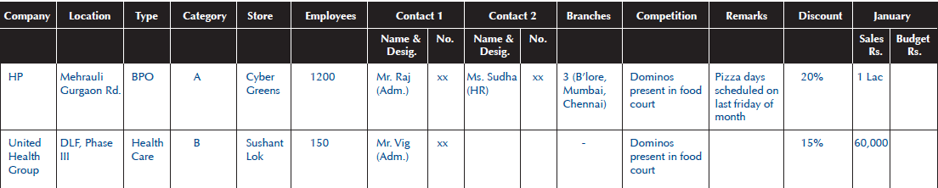
Example
Notes:
SAY- Here is a sample of how the corporate database can be structured.

Slide 153
Approach key decision makers
Step 3 - Corporate kit to reach out to HR/Admin head-
    Brief introduction
    Corporate leaflet
    E-mail with offers (Bulk Order Slabs)
    Employee discount
Notes:
ASK- Who are the key decision makers in corporate offices?
GET RESPONSE –
Office assistants & secretaries
Office administrators
H.R., personnel department, and training teams.
Individuals

Slide 154


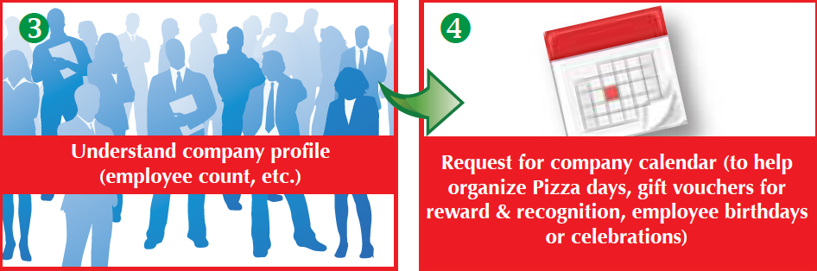
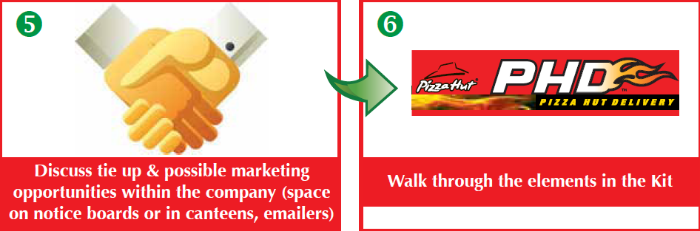
Script Flow
Notes:
DISCUSS THE SALES CALL NUANCES–
Appearance & grooming
Importance of taking notes
Marketing material to be carried

Slide 155
Customer contact report
Date | 15th Aug, 2013 | 16th Aug, 2013
Account Contacted | Indigo Airlines (Global Business Park) | Genpact (Golf Course Rd)
Remarks | Discussed bulk order for annual celebration | 100 gift voucher of Rs 250 to be delivered on 25th of August
Mode of Contact | Visit | Telephone call
Contact Person | Susan Andrews | Pritam Kumar
Notes:
SAY- Here is a sample of how the sales visits can be tracked and followed up.
Remember the relationship is based on regular interactions. Face to face interactions especially in the initial phase is helpful in building a strong relationship.

Slide 156
Corporate Sales ..key steps
Identify Opportunity
Gain Visibility & Incentivize
Step 1 Build database
Menu booklets
Step 2 Gather information
Posters
Step 3 Visit process
E mailers
Discounts on Bulk orders
Discount for employees
Corporate discount deals
Notes:
SAY- Let us discuss the means to building visibility and incentivizing corporate customers to order with us.

Slide 157

Gain Visibility
Poster in canteens/notice
boards
Pizza day communication
Art work can be ordered
Notes:
ASK- How will poster help in building sales?
GET RESPONSE
Poster will create awareness and build connect .

Slide 158
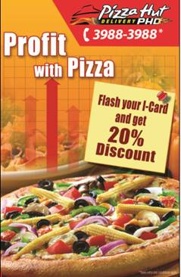
Gain visibility and incentivize
Poster in canteens/notice
boards
Corporate discount communication
Art work can be ordered
Notes:
ASK- Why are discounts important in our corporate sales strategy?
GET RESPONSE
Companies order large quantities and expect discounts. Our

Slide 159

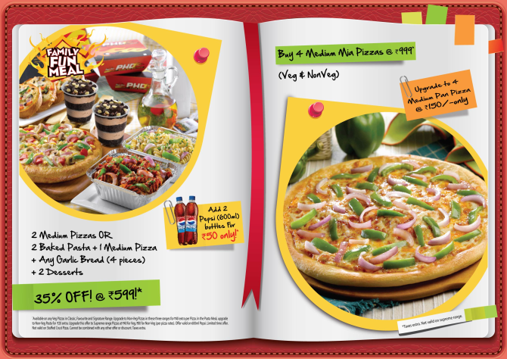
Gain visibility and incentivize
Corporate menu booklet
A3 Size menu booklet
Durable booklet
Offers on bulk &
Individual orders
Hand deliver to office
administrator
Art work can be ordered
Notes:
ASK-
Why should we have a separate corporate leaflet?
How will this leaflet be different from the regular leaflet.
GET RESPONSE -
Corporate customers have different needs and hence the corporate leaflet with different offers.
The corporate leaflet needs to be bigger and stand out. It should also be more durable (higher GSM)

Slide 160
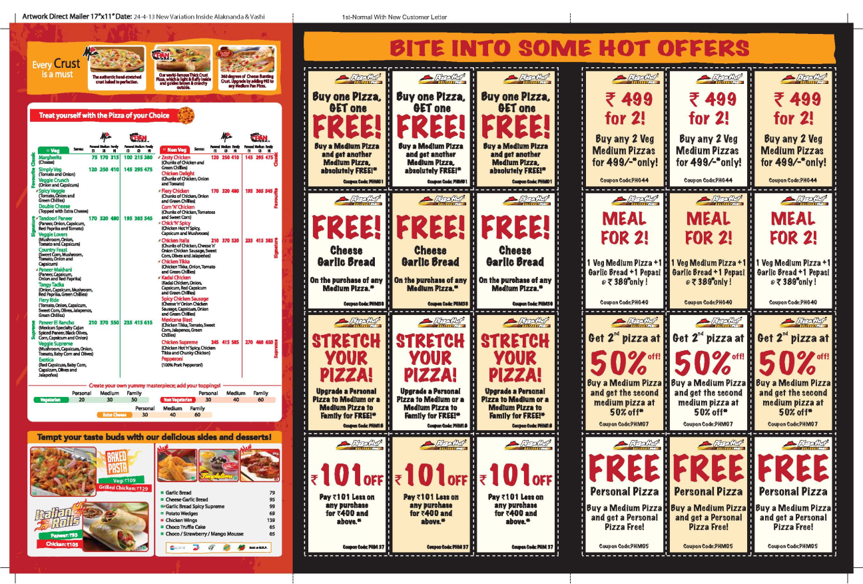
Gain visibility and incentivize
Direct Mailers
Attractive offers on
bulk & individual orders
60 days validity
Art work can be ordered
Notes:
SAY- Direct mailers with offers are an excellent way to penetrate offices where entry is restricted. Data base is crucial to activate direct mailers.

Slide 161

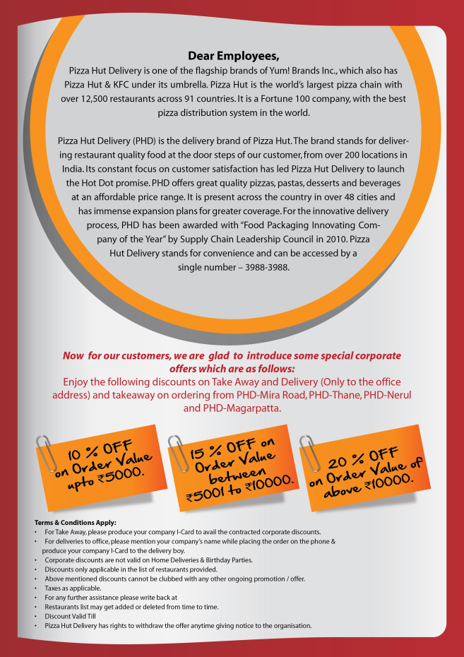
Gain visibility and incentivize
Employee letters
Exclusive Offer for _________ Employees
Dear _________,
Thank you so much for your valuable time, it was a pleasure meeting you . Attached you will find some exclusive offers for you and every employee belonging to __________ .
.
Requesting you to cascade these special offers to all employees so they can start availing their exclusive discount from Pizza Hut Delivery. It would be great if you could share my contact details as well. This way, they can get in touch with me directly for any queries or feedback.
Looking forward to serving the best pizzas to _________ and creating a long term relationship with Pizza Hut Delivery. .
For any further assistance, please feel free to call me anytime.
Yum to you!
☺
( )
Restaurant General Manager
Personalized letter from RGM
Attractive employee
discounts
Art work can be ordered
Notes:
SAY- Personalized letters to employees build connect with the individual.

Slide 162
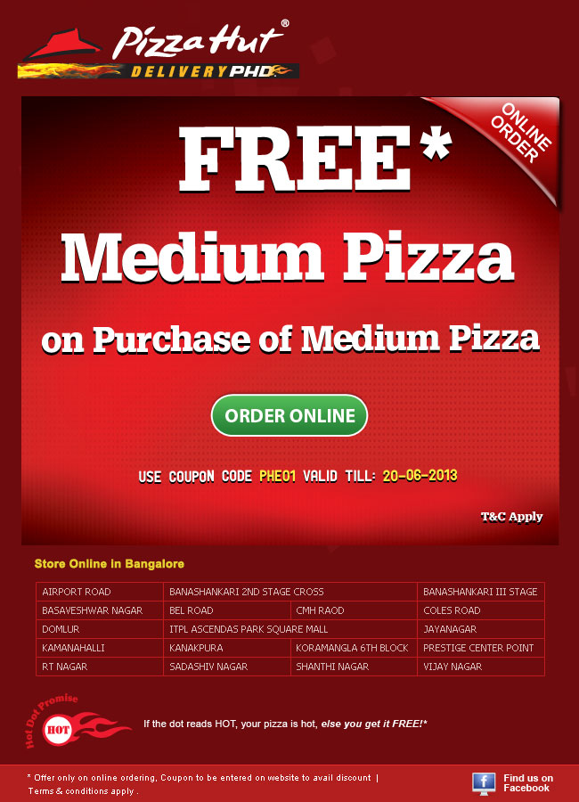
Gain visibility and incentivize
E-mailers/SMS with special
offers
Sent to email database
Option to order online or
via call center
Art work can be ordered
Notes:
SAY-Since most employees in offices are connected to their mails almost through out the day, e-mailers help in reaching out to them. E-mailers & SMS are cost effective means of communicating with our customers.

Slide 163
4 levers & tools
Assess viability
Tactical programs
Taking it to the team
Redemptions
Notes:
SAY- Before launching any LSM activity it is important to assess if the offer is viable.

Slide 164
Assess viability
Can you afford it
Targets for success
Notes:
SAY – 2 Aspects to assessing viability –
Can the business afford LSM – Financial viability
Measuring success – LSM target vs. actual achievements

Slide 165
Assess viability
Can you afford it
Targets for success

Slide 166
Can you afford it
Any LSM will be viable only if the increased sales and the Flow Through compensates the costs incurred
Costs incurred?
Flow Through?
Notes:
SAY-All LSM impacts 3 aspects of our business-
Sales or ‘Top line’
Costs or ‘ Bottom line’
Profit
ASK- What is flow through?
GET RESPONSE
Flow through is the rupee value impact on profit from
the incremental sales after considering impact on all
costs.

Slide 167
Can you afford it?
In a store there are different kind of costs
Variable Costs
Semi Variable Costs
Fixed Costs
LSM related costs: Costs of marketing collateral, discount on food, semis
Costs that vary as a direct % of the sale generated…
Eg… Food Cost, AMP, LSM
Other existing costs
Costs that vary slightly as a result of increased/ decreased sale
Eg… Cost of Labour, Cost of Utilities etc
Costs that are constant and are not affected by increased/ decreased sale
Eg… Fixed rent, Corporate over heads
Notes:
ASK – If you are managing your household expenses, what are-
Fixed costs
Variable costs
Semi variable costs
GET RESPONSE
Fixed cost – rent
Variable cost – entertainment
Semi variable costs - electricity, water, fuel, grocery etc.

Slide 168
Can you afford it?
Since majority of the costs are of a fixed or a semi variable nature there is a minimum amount of sale that a business needs to generate to deliver a Profit after covering all variable costs.
If sales exceed this minimum amount, the contribution towards the bottom line increases significantly for each additional rupee generated as the all the fixed costs and most part of the semi variable are already covered
Notes:
ASK- Please explain what this statement means?
GET RESPONSE –
Check if participants understand the concept of ‘contribution’

Slide 169
Case study
PHD Halla Bol does an average daily sale of Rs100000/-, the Cost of food % is 30% and sum total expenditure of their various Semi variable costs amount to 20%. They have a monthly fixed expense of Rs 20000/-
RGM has executed an aggressive LSM Bogo offer which increased sales by 50%, but increased his overall cost of food by 6%. This Promotion further increased the semi variable costs by additional Rs.5000
Did the store make more money or lost money ?
Notes:
SAY- PHD Halla Bol implements a BOGO offer. Here are how the sales and costs change.

Slide 170
Case Study
Before LSM
Before LSM
After LSM
After LSM
Sale 100K 150K
Variable Cost 30K 54K
Semi Variable Cost 20K 25K
Fixed Cost 20K 20K
Profit 30K 51K
100%
100%
30%
36%
20%
17%
20%
13%
30%
34%
Notes:
SAY- Variable cost (COS) will increase since it is a BOGO offer. Semi variable cost will increase marginally. The teams need to calculate the impact of the promo on the P&L on the basis of the information provided
ASK- How will this promo impact profits? Is the business better off after the promo?
DISCUSS ANSWER AFTER SHOWING THE ANSWER ON THE PRESENTATION

Slide 171
Targets for success
A successful LSM is one when incremental sale is higher than incremental cost + marketing cost of promotion
=
Sale
Txn
X
APC
A capable RGM will determine his Targets before any LSM
Target Sale
increase
=
Target
Txn increase
Target
APC
X
Target Profit increase
Notes:
SAY- To make any promo successful we need to set ourselves transaction and APC targets.

Slide 172
Case study on PHD Halla BOL
PHD Halla Bol current ADS
Current Sale
Current Txn
Current APC
=
100000
200
X
500
RGM is considering a BOGO offer
In order for the LSM to be successful the store needs to take the ADS upto 1.3 Lacs.. The cost of food will be 35%, cost of variable cost will increase to 45K/ month, Fixed cost will continue to remain at 20K /month
Determine the following
Target Sale
increase
=
Target
Txn increase
Target
APC
X
Evaluate Profit increase
Can The Store Afford it?
Notes:
ASK- Given the data of PHD Halla Bol, work within the teams to answer the following questions –
What is the profit made from this offer?
Can the store afford this offer?

Slide 173
Case study on PHD Halla BOL
 | Current |  | Impact of Promo
Sale | 100000 | 100% | 130000 | 100%
COS | 30000 | 30% | 45500 | 35%
SV | 40000 | 40% | 45000 | 35%
FC | 20000 | 20% | 20000 | 15%
Profit | 10000 | 10% | 19500 | 15%
Target Increase in sale
Target Increase in Txn
Target APC
=
30000
60
X
500
Evaluate Profit Increase
Assume ..no increase in APC
Rs 9500
Can The Store Afford it?
Notes:
GET RESPONSE-
PHD Halla Bol post LSM–
Profit – Rs 9500/- additional profit generated.
Affordability – yes.
SAY - Additional information needed is the expense incurred on marketing collateral (Leaflets/SMS/Emailer/Poster etc)

Slide 174
4 levers & tools
Assess viability
Tactical programs
Taking it to the team
Redemptions
Notes:
SAY- RGM can choose which levers to trigger, choose from tactical programs and then assess viability. The next step is to take the targets to the store team.

Slide 175
Taking it to the teams
Shift wise Target
Individual wise target
Engage with teams
Notes:
SAY- There are the 3 steps to ensure that everyone is clear on the target. Clarity in targets and consistent communication will drive results.

Slide 176
Shift wise Target
What
Upsell product/promo. CSR wise targets &
incentives
When
Targets shared at the beginning of every shift
How
Targets posted on daily briefing sheet.
Previous days winning CSR’s to be announced
Notes:
ASK- Why is it important to give shift wise targets?
GET RESPONSE –
All targets need to be broken down so that there is constant focus.
Shift-wise targets can be evaluated and quick corrective action can be taken in case of deviations.
If team is achieving targets, shift-wise recognition will ensure that we maintain momentum to achieve the weekly and monthly targets.

Slide 177
Individual targets
CSR
All CSR’s have a daily up sell or sell more
target
RIDER & BOH
Pod ownership daily and weekly targets. All
team members to be part of a pod ownership
team
Notes:
ASK- Why are individual targets important?
GET RESPONSE
All targets are to be achieved by the team. Each individual needs to know what their contribution to the overall target is.
SAY- Sales incentives are an important aspect for in store sales building. Incentives are strong motivators and help when we are setting out to achieve ‘Break thru’ sales targets

Slide 178
Engage with teams
What
Communicate targets & incentives
How
Update team on results
When
Update during the pre-shift briefing
Notes:
ASK-
At what forums do we communicate targets and performance?
How often should we communicate?
GET RESPONSE
Targets and achievements should be communicated
during all shift briefings.
Sharing achievements during peak periods helps in
boosting moral and teams energy.
SAY- It is important to make recognition fun.

Slide 179
4 levers & tools
Assess viability
Tactical programs
Taking it to the team
Redemptions
Notes:
SAY- After executing any initiative, it’s the results that rate the quality of the execution

Slide 180
Tracking redemptions
It is important to track redemptions for all LSM offers
Why ?
1.
Gives us information on which offers our customers prefer.
2.
Tracking redemption is a deterrent to wrong financial practices
3.
Knowledge of redemption gives us inputs on how to effectively generate sales
How is redemption tracked ?
Total transactions from LSM
Redemption %
=
Total customers who received offer
Notes:
ASK-
1. How can we ensure redemption tracking is accurate?
2. How does redemption data help a RGM in growing sales?
GET RESPONSE
Coupon codes and IT update of those codes are very important to track redemption.
Redemption data will indicate which offer works well in a particular stores trade zone. The effectiveness of the medium of communication can also be ascertained.

Slide 181
Happy Selling

Slide 182
Measuring Results
5.
Measuring
Results
4.
Local Store
Marketing
1.
Understanding
Sales
3.
Maximize sales outside the store
2.
Maximize sales inside the store
Notes:
SAY- What get measured gets done. It is important to constantly look at the measure to understand the impact of our activities. This helps us know what is working well and what we need to do to improve.

Slide 183
Business measures
It is important to measure results of all LSM programs or promos that we launch
What are the business measures?
Delivery
Takeaway
1. New Customers
1. APC
2. Lapsed Customers
2. Transactions
3. Re-activated customer
4. Active Customer
Ordered within the past 90 days
Notes:
SAY- We have different measures and indicators for delivery and takeaway. Each of these measures are important while assessing the success of all BTL activities.
ASK- What are some of the other measure which you will review to check impact of BTL activities undertaken?
GET RESPONSE
SSSG & SSTG
Sales and transaction growth over previous period
Unit contribution (UC)

Slide 184
Business measures- delivery
1. New Customers
Placing order for the first time
Placing order after 365 days
2. Lapsed Customers
Not placed order for 90 to 365 days
3. Re-activated customer
Lapsed customers who reorders
4. Active Customer
Ordered within the past 90 days
Notes:
DISCUSS WHAT EACH OF THESE MEASURES MEAN TO OUR BUSINESS. HOW CAN WE IMPACT EACH OF THEM

Slide 185
NNC is key measure to establish the health of our delivery business?
Notes:
SAY- ‘Net new customer’ is a new KPI which is now available in our POS report. This measure is extremely vital to the health of our delivery business.

Slide 186
Net New Customers
Net New Customer
New Customers
Lapsed Customers
=
-
Notes:
ASK- Why is net new customer important for our business?
GET RESPONSE
In delivery business we need to increase new customers and increase out database. Lapsed customers indicate that customers are unhappy with service , product or value. We need to address these customer concerns and give value by offering aggressive discounts to win them back.

Slide 187
What are the reasons for low Net New Customers?
Low new customer acquisition
or
High Lapsers
What do we do if Net New Customers is low?
Notes:
ASK - What do we do to increase net new customers?
GET RESPONSE - Increase new customer and reduce lapsers.

Slide 188
Actions for low Net New Customers
Low new customer acquisition
1. Identify the pods where new customers are low
2. Identify office and residential buildings which are
under penetrated
3. Review execution of leafleting in Hot & Warm pods
4. Review pod optimizer scoring
Notes:
ASK – How do I know which areas on should focus on to acquire new customers?
GET RESPONSE
Know trade zone house counts. Update every 6 months
Have accurate alpha listing and hard code data.
Have corporate and institutional database.
Identify which pods are not penetrated
Identify offices which do not order or order rarely.

Slide 189
Actions for low Net New Customers
High Lapsers
1. Identify pods where lapsers are high.
2. Ensure speed & service KPIs are being met.
3. Review competition activity in the pods where
lapsers are high.
4. Have strong call back and direct mailing process
to win back lapsed customers
Notes:
ASK-
Where do we get lapsed customer data?
Do we receive pod-wise lapsers?
GET RESPONSE –
The IT system should be set up to provide this data. The organization may choose to restrict access rights to this database. It is important that lapsed customer data is constantly reviewed and acted upon. We need to win back every lapsed customer. More importantly we need to reduce lapsers month on month.

Slide 190
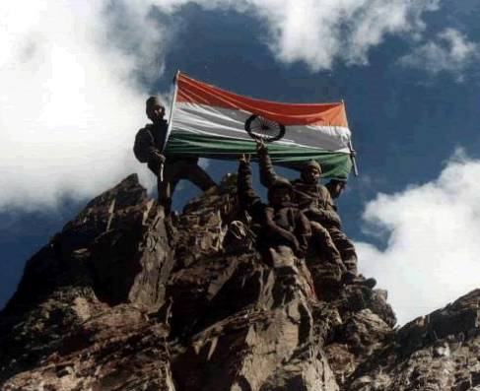
Lets Win This Battle for our Trade Zone’s
Notes:
SAY- How do we evaluate the success of this workshop? The true measure of success of this program is when the following elements of Own The Zone are executed well-
Trade area mapping and house counts refreshed every 6 months.
Accurate alpha listing and hard coded data for every trade area.
RGM’s identify sales opportunities. They plan and execute LSM to address the opportunities.
When we achieve 1200 PHD transactions per week. SSSG is growing at 15%
DISCUSS AND DOCUMENT NEXT STEPS. SHARE NEXT STEPS WITH OPERATIONS LEADER.

